Slide 1
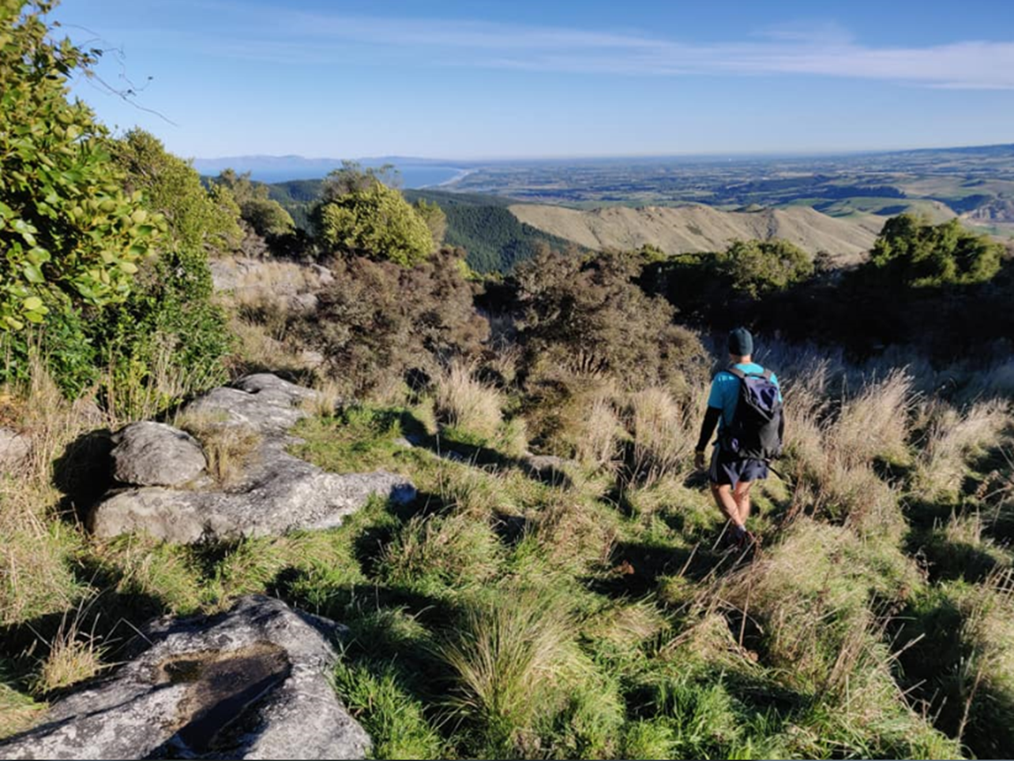
Biodiversity in the Hurunui

Slide 2
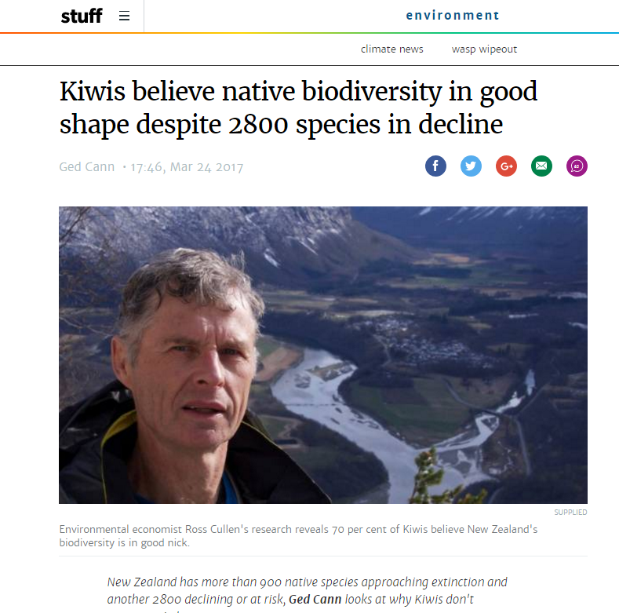

Slide 3
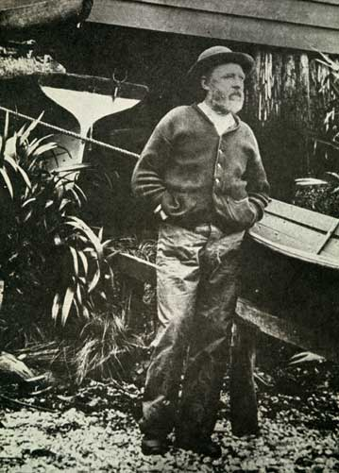
Just over one hundred years ago…
"On the west, from the mouth of the Waiau for 25 miles of beach, there are neither signs nor sounds of kakapo, weka, nor kiwi, where they used to be numerous, but there are plenty of ferret tracks on the beach. Up the creeks in the bush grey teal and blue duck were plentiful, but now they are all gone, and the black teal are rapidly going also, and in all probability will soon be simply a memory of the past.”
– Richard Henry.

Slide 4
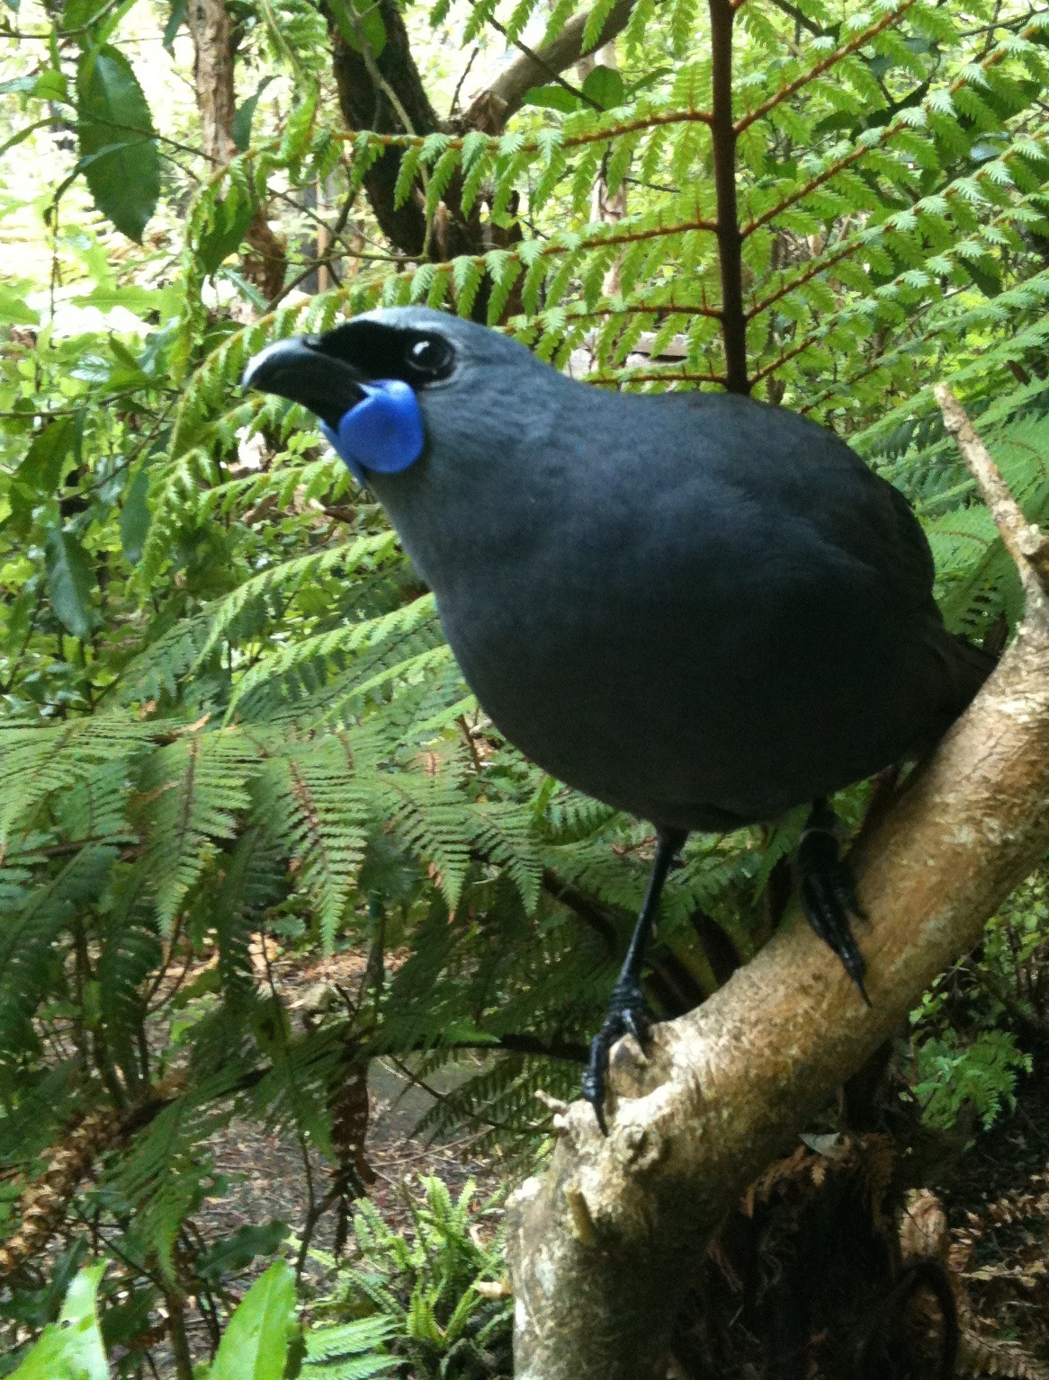

The state of our native species
4000 classified as ‘threatened’ or ‘at risk’
+900 classified as threatened & face risk of extinction
50+ bird species have become extinct in the 750 years since human arrival (plus bat, frogs, plants, reptiles…)
Possums, rats & stoats -main mammalian predators
Notes:
Our unique plants and animals define New Zealand and add immeasurable value to our culture, our identity, and our wild places.
About 80% of our invertebrates, 70% of our birds, 84% of our freshwater fish, and 80% of our trees, ferns and flowers plants are ours alone.
But due to our country’s unique natural history and the threats from introduced predators, invasive species and habitat loss, our species extinction rates are among the highest in the world.
In the 750 years since human arrival, at least 76 bird species have become extinct, three frogs, at least three lizards, on freshwater fish, four plants and an unknown number of invertebrate species.
More than 3000 of our native species are within the ‘threatened’ and ‘at risk’ categories. Around 800 of these are classified as threatened and face extinction if we don’t act promptly.
Amongst the introduced predators, possums, rats and stoats have found our native animals to be easy prey as our native animals evolved without the presence of such predators and have no defence against them.
[Picture – kōkākō]

Slide 5
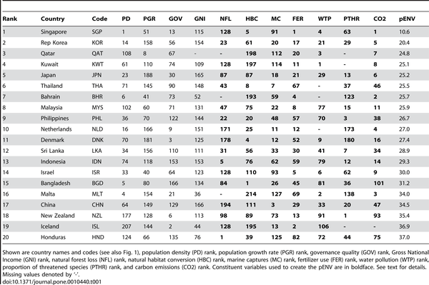

Table 1. Twenty worst-ranked countries by proportional composite environmental (pENV) rank (lower ranks = higher negative impact).
Bradshaw CJA, Giam X, Sodhi NS (2010) Evaluating the Relative Environmental Impact of Countries. PLOS ONE 5(5): e10440. doi:10.1371/journal.pone.0010440
http://journals.plos.org/plosone/article?id=10.1371/journal.pone.0010440

Slide 6
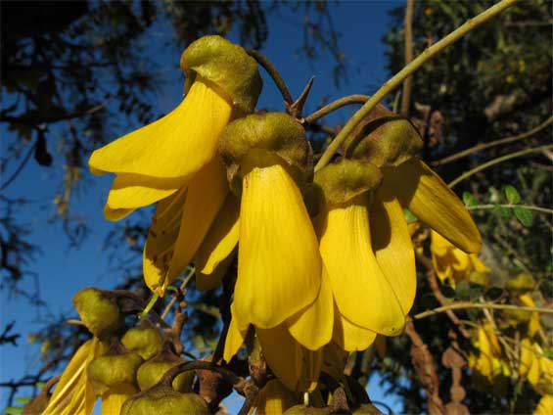
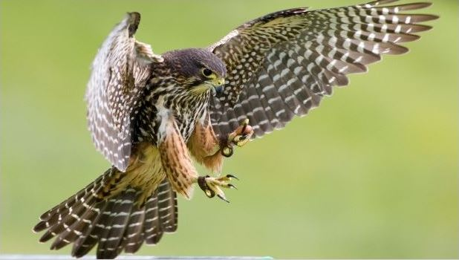
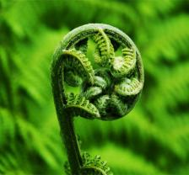
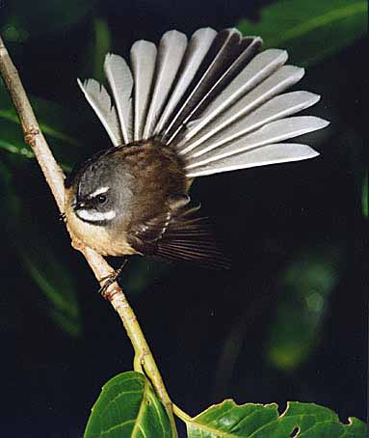
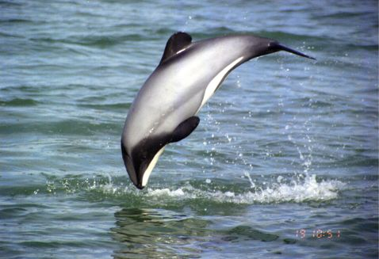
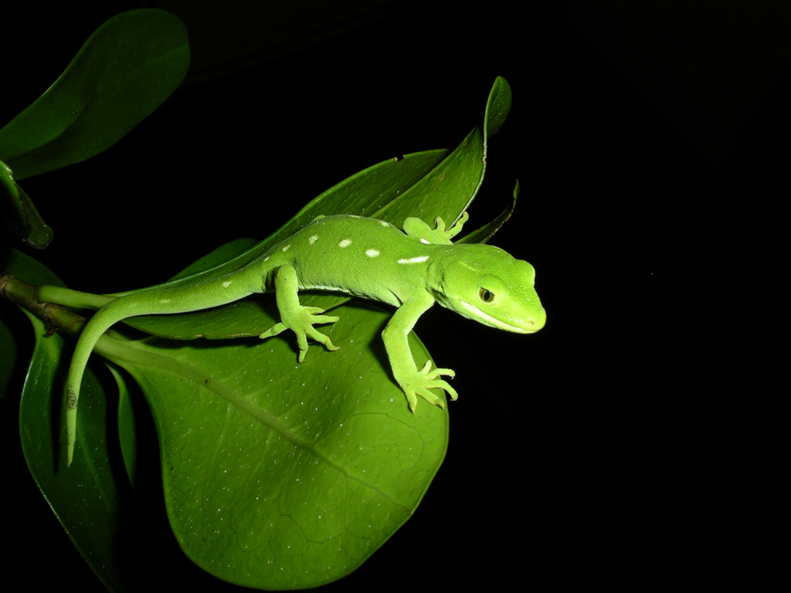
National identity
Notes:
This is who we are. We are all people of the land, who identify with the land, who associate ourselves as people of our home land and sea. We are rapidly losing it.

Slide 7
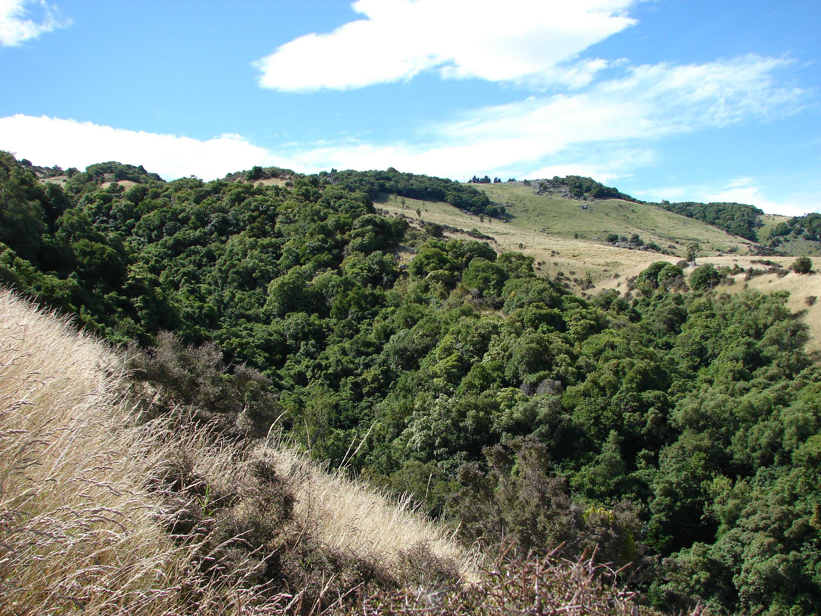
Local Identity?

Slide 8
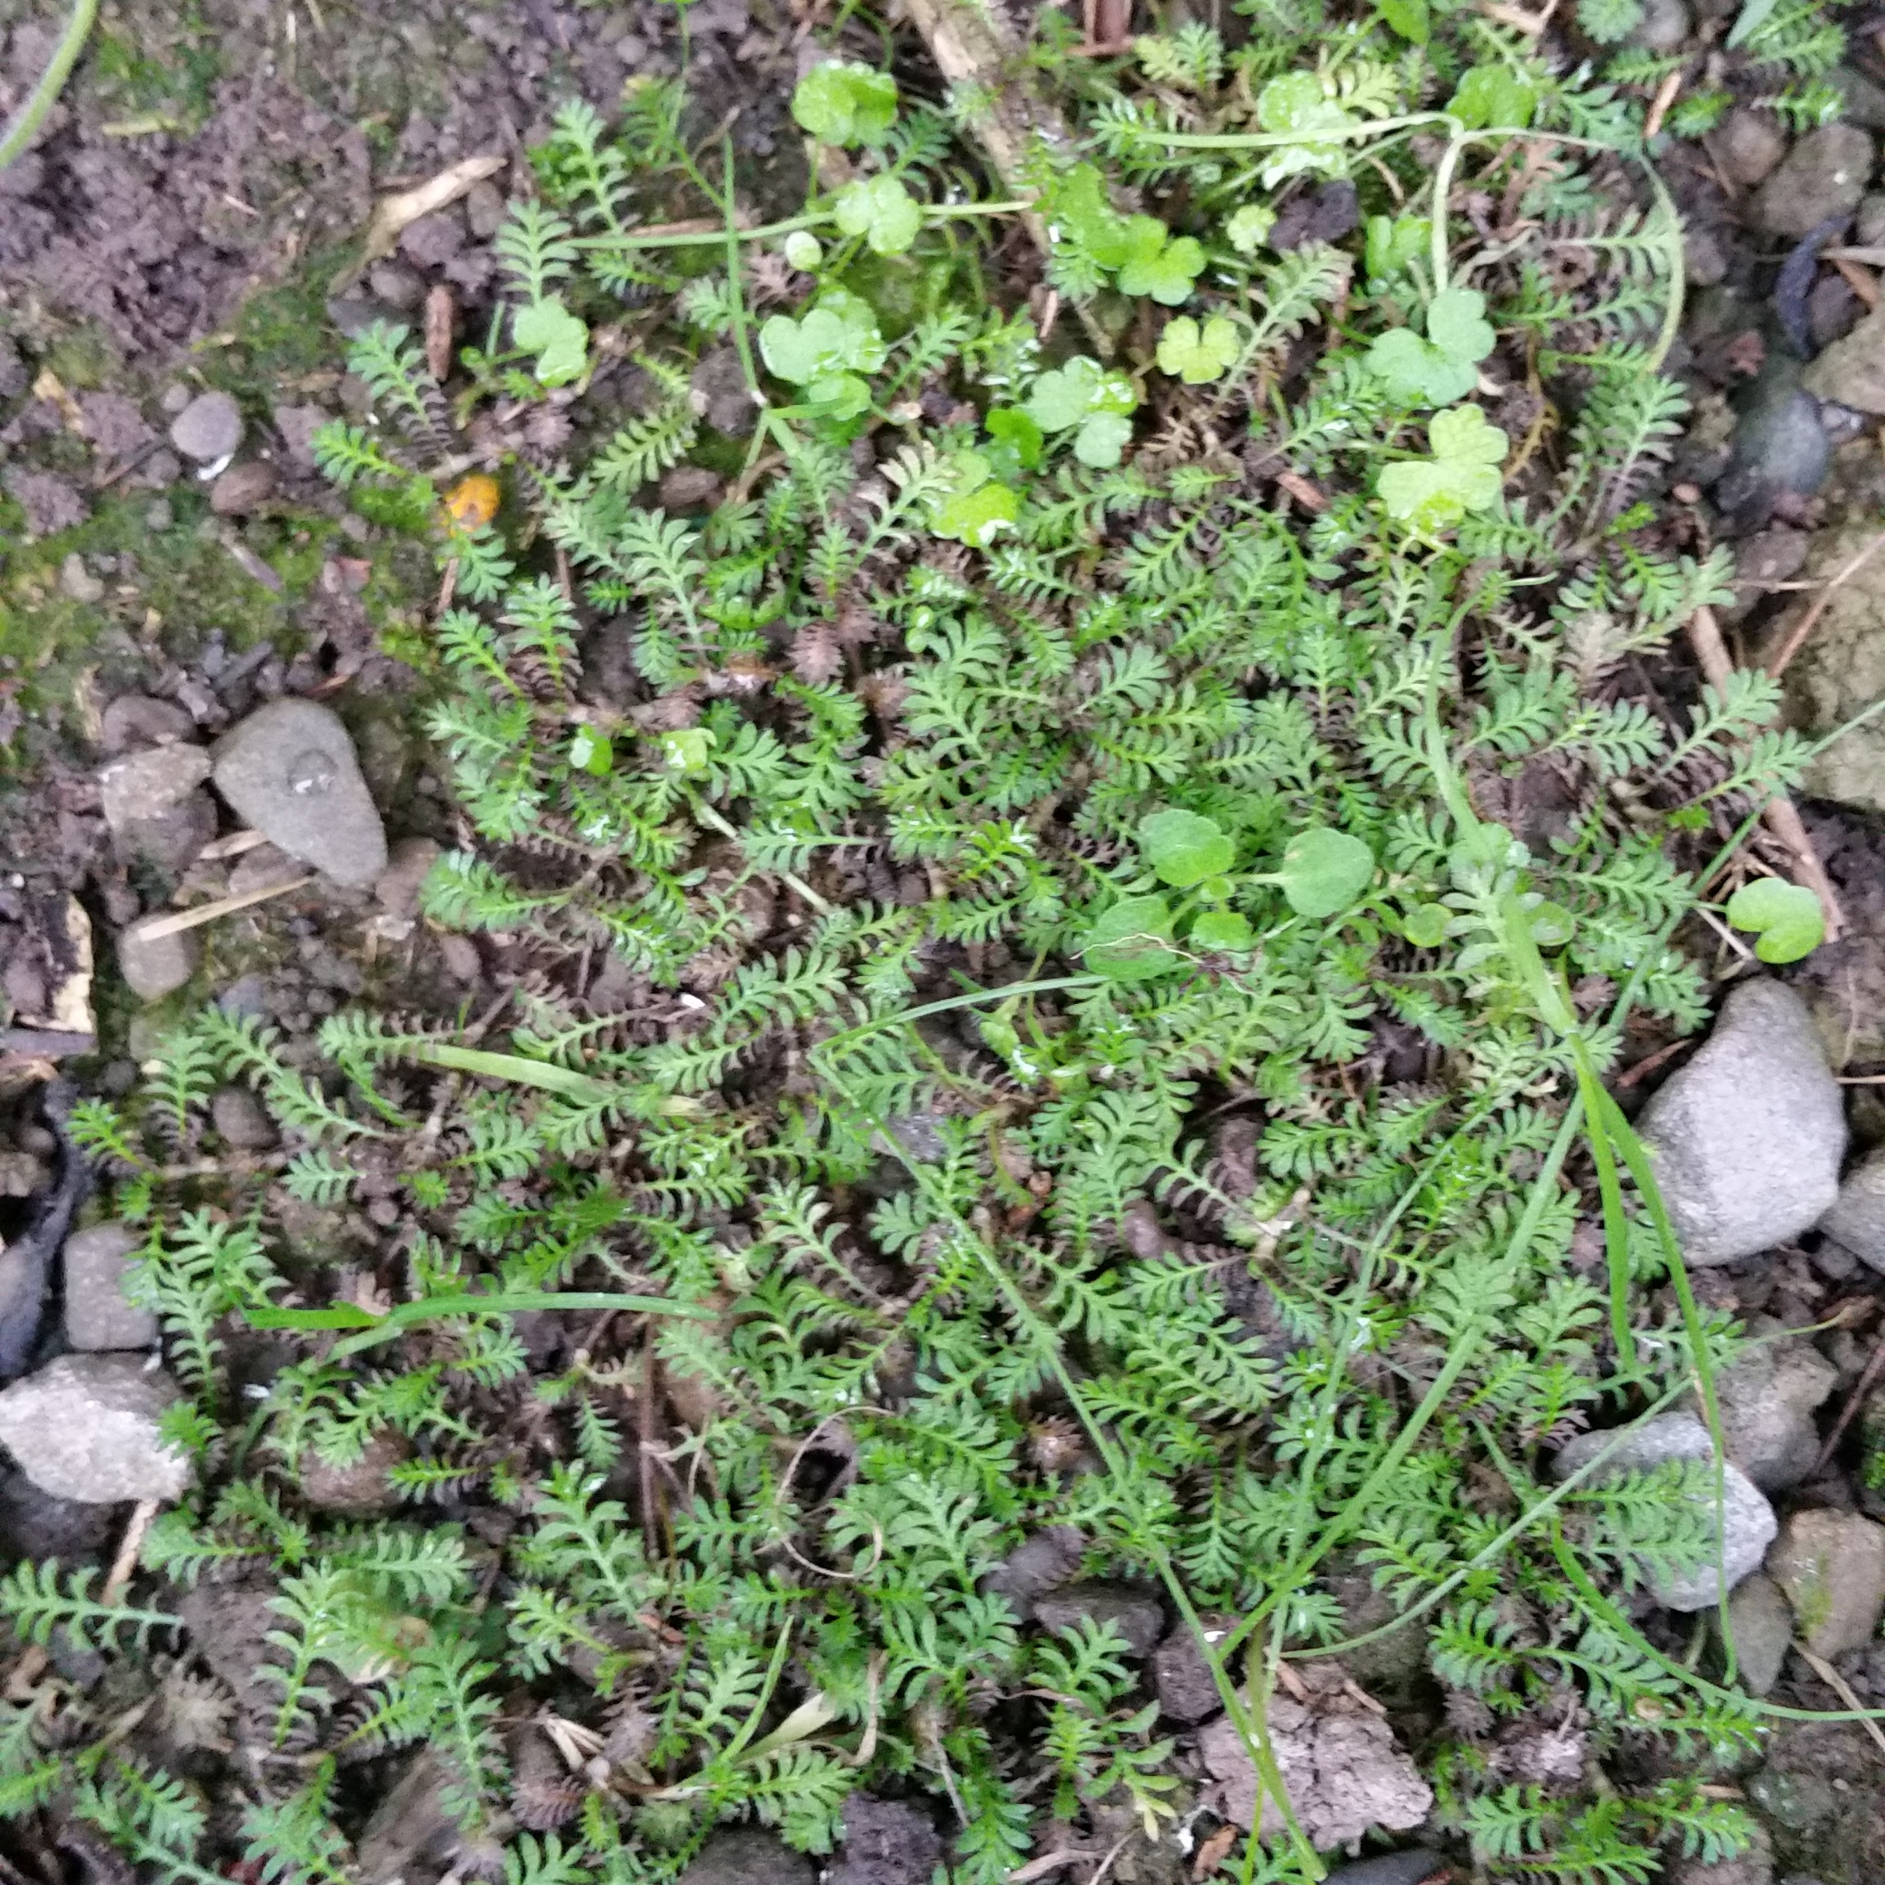
The little green takahē
Declared extinct
Found again in the Heritage Hotel lawn, which then got developed.
Someone saved some
Now trying to grow at home (and at the neighbours!)
This is where story matters!

Slide 9
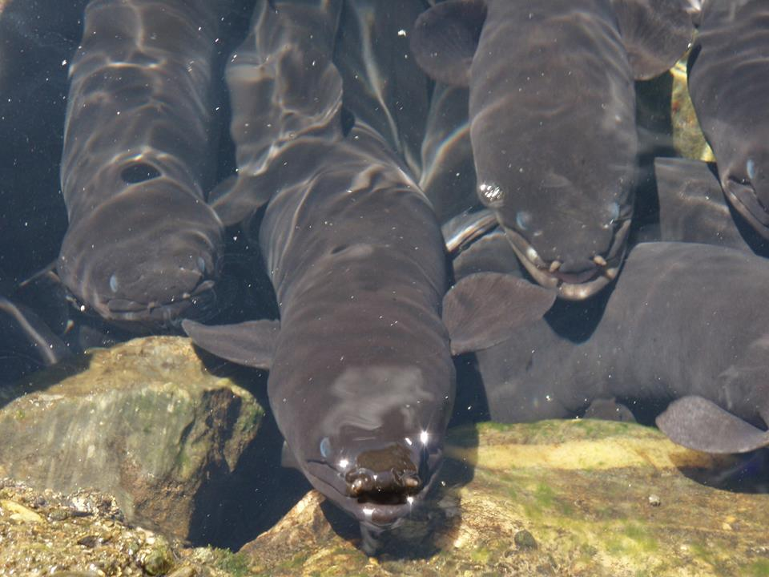
An eel-y good story – from the past to the future….

Slide 10
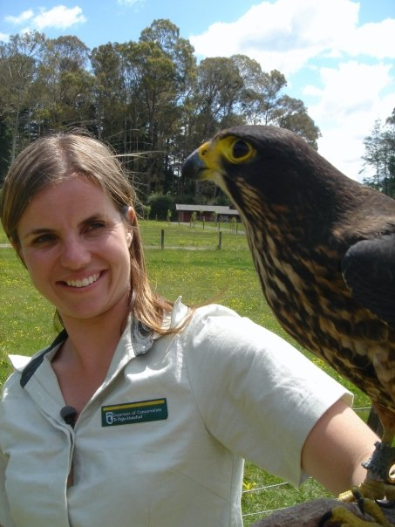

Slide 11
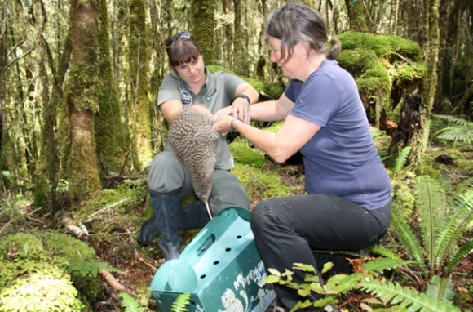

Slide 12
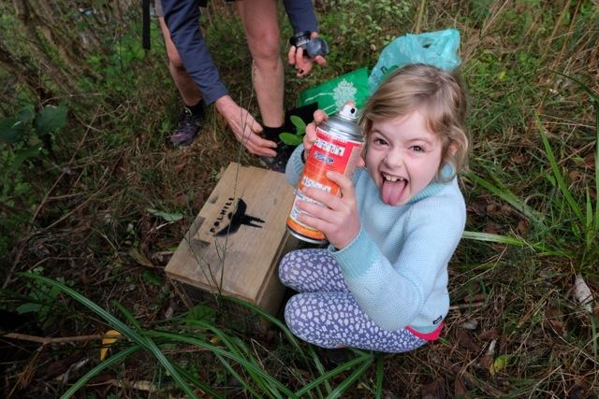
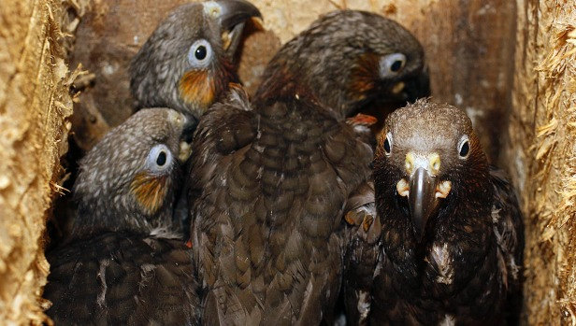
Predator Free 2050
An ambitious goal to rid New Zealand
of possums, rats & stoats
Struck a deep chord with people across New Zealand
Notes:
On 25 July 2016, the Government committed to the goal of New Zealand being free of possums, rats and stoats by 2050. These are the most damaging introduced predators threatening our nation’s natural taonga and economy.
The Predator Free 2050 programme will deliver huge benefits – for the social and cultural links with our environment, for our regional economies through primary industries and tourism, and for our threatened native species.
Predator Free 2050 has struck a deep chord with the people of New Zealand, reflecting our attachment to our species and landscapes.
Feedback and comment from conservationists, scientists and even political commentators has been overwhelmingly positive.
Of a predator-free New Zealand, the late Sir Paul Callahan said: “It’s crazy and ambitious, but I think it might be worth a shot.”
He also said: “This could be our Apollo programme.”
The Predator Free 2050 goal is our ‘moonshot’. Yes, it’s an aspirational goal, but it’s a goal that’s worth aiming for.

Slide 13
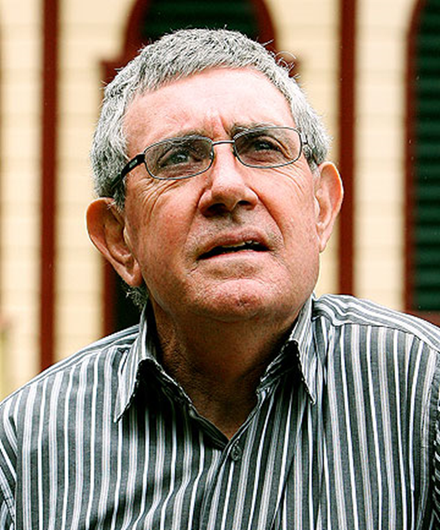
“It’s crazy and ambitious, but I think it might be worth a shot.”

Slide 14
How Crazy?
A legacy of introduced mammals has destroyed our native birdlife.
But we are world-leaders in large-scale predator eradication.
Our area of eradications goes up by an order of magnitude every decade.
The last one was 11000 ha… it’s almost time for 100 000!

Slide 15
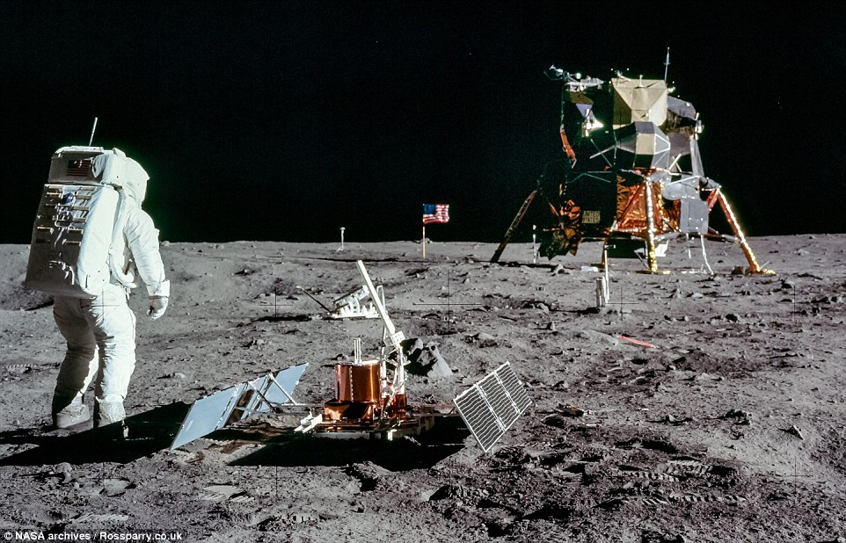
“This could be our Apollo mission.”

Slide 16
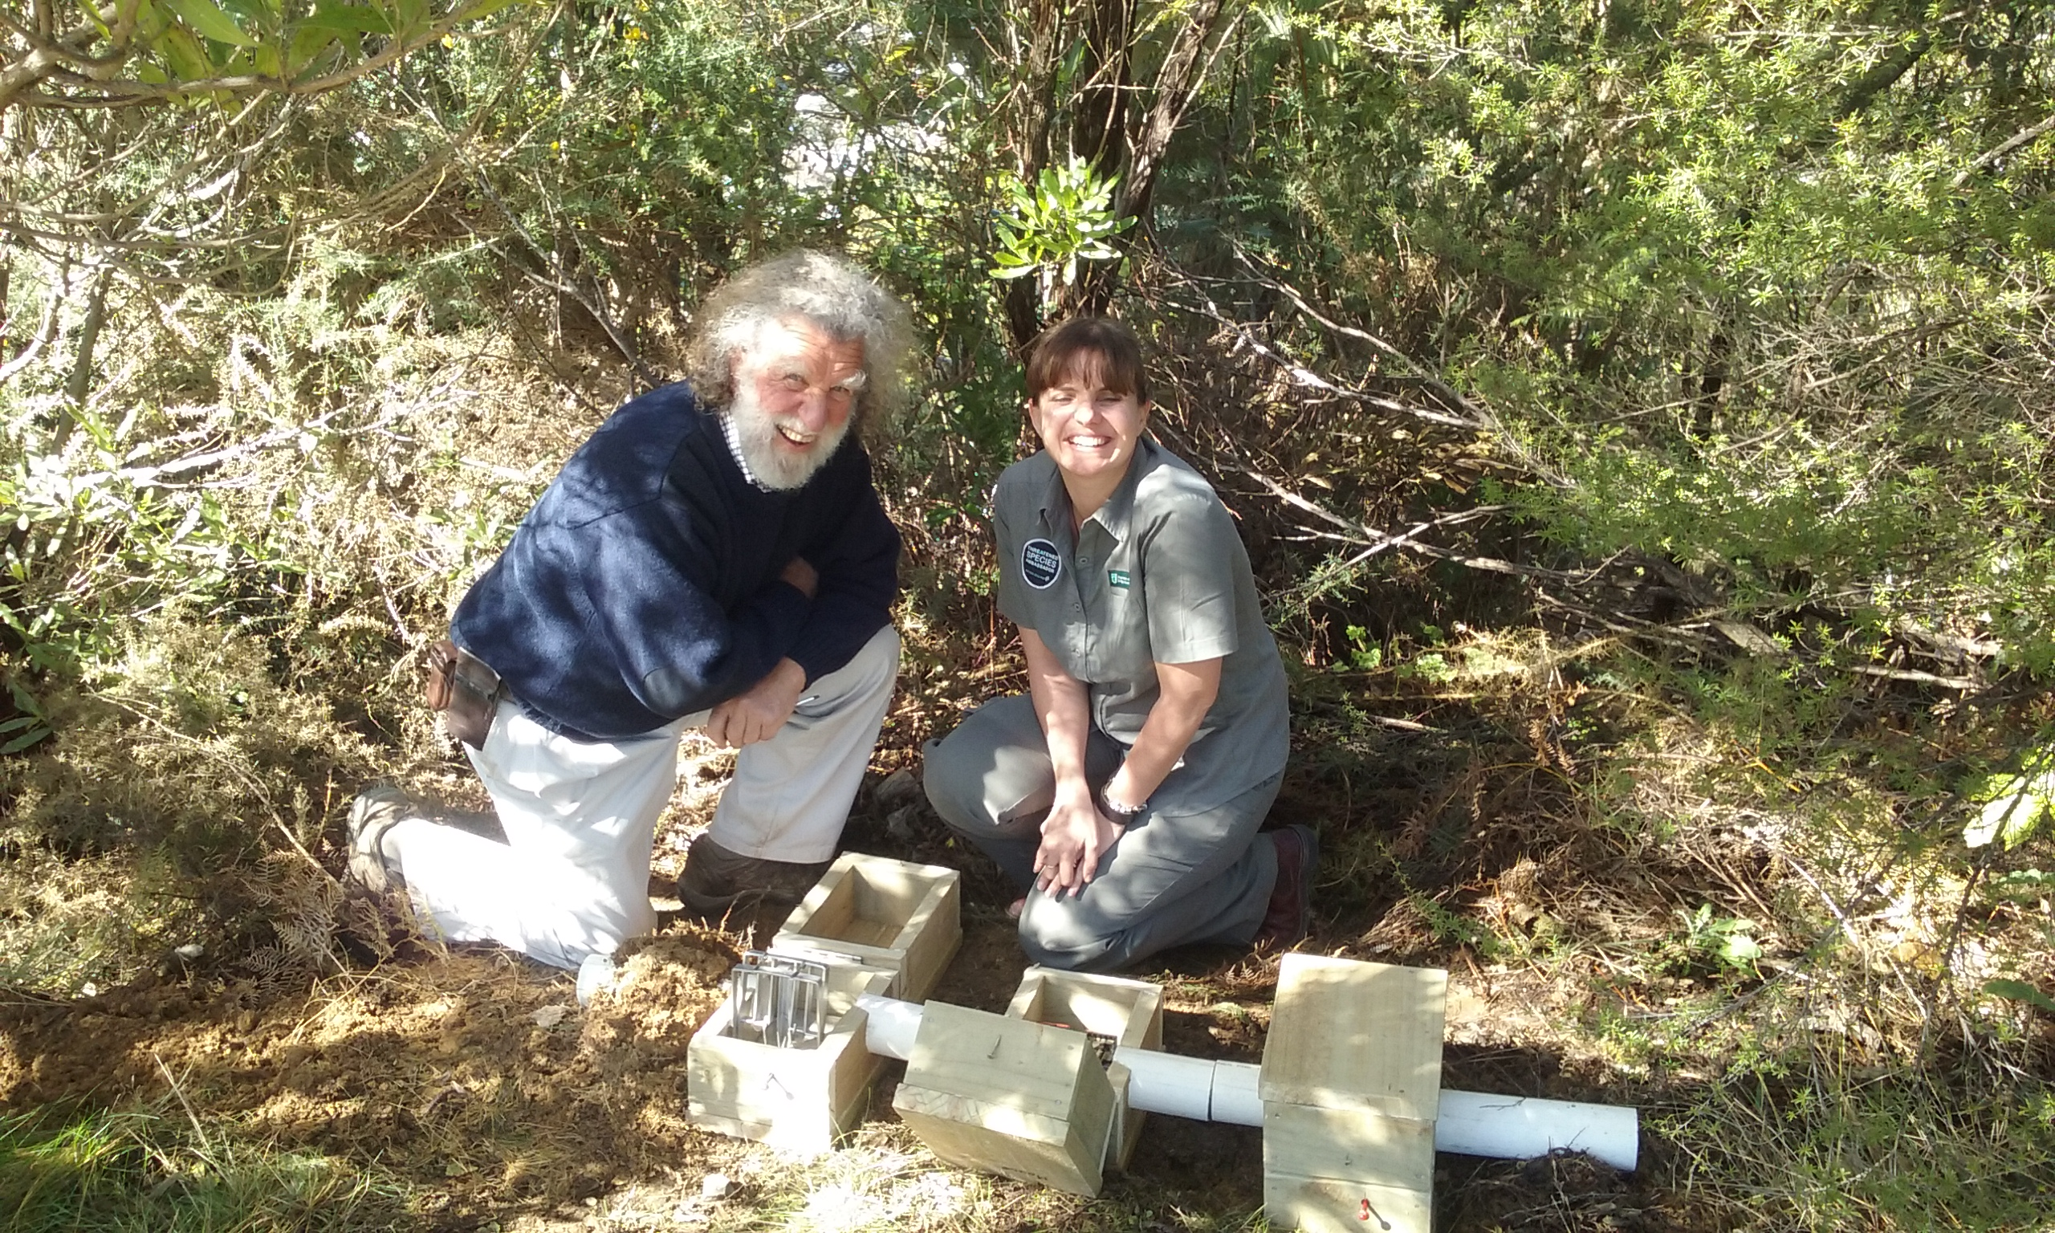
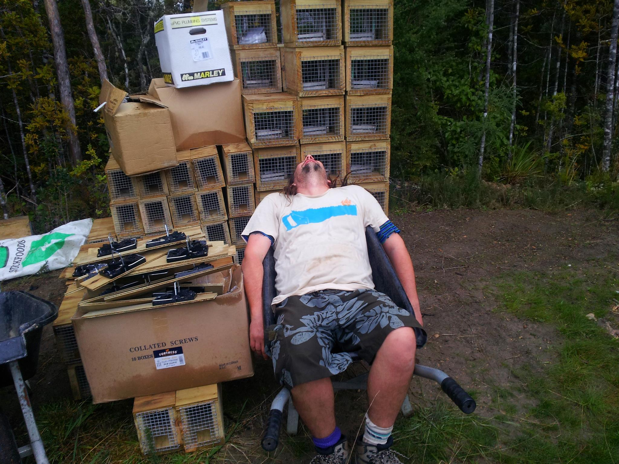
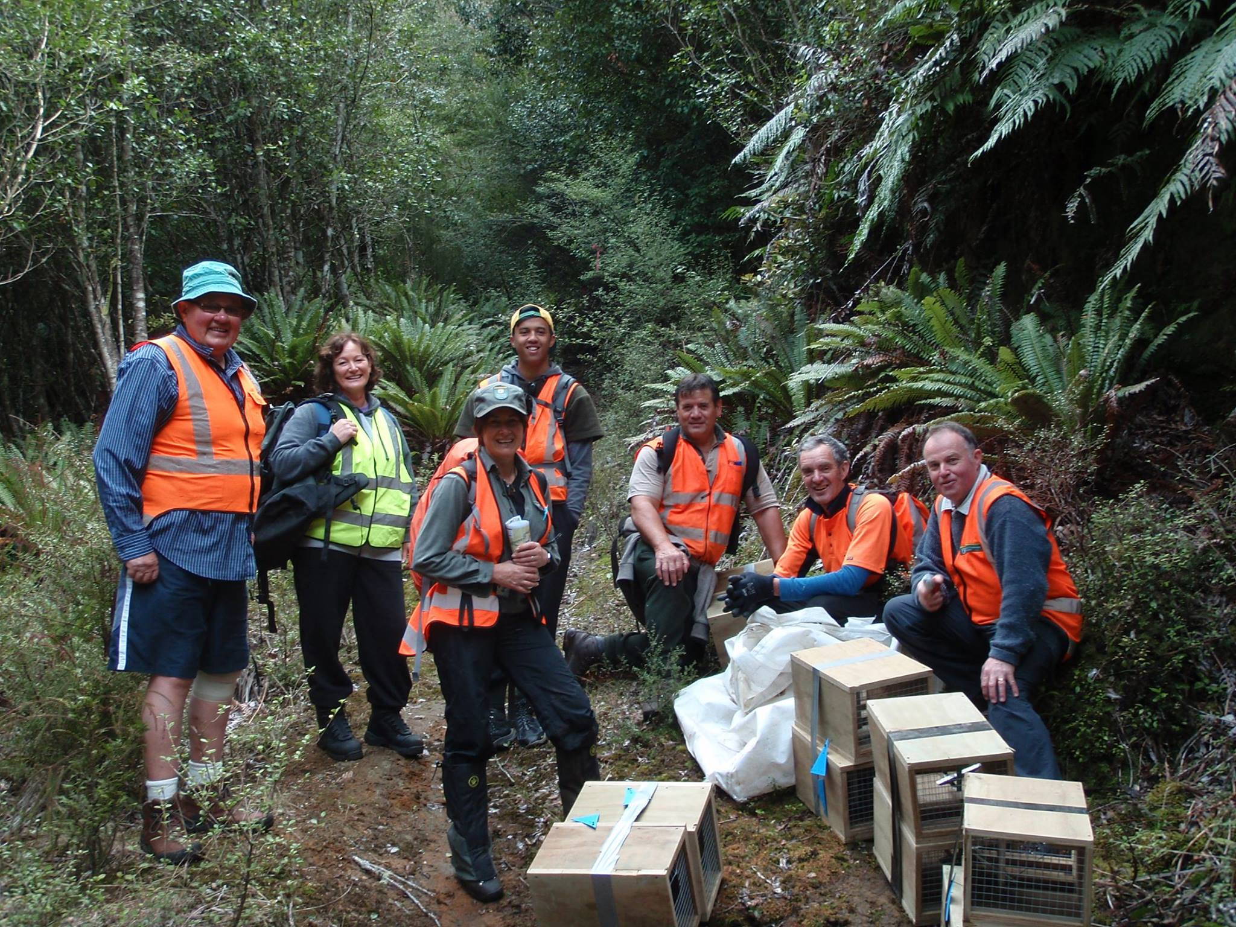
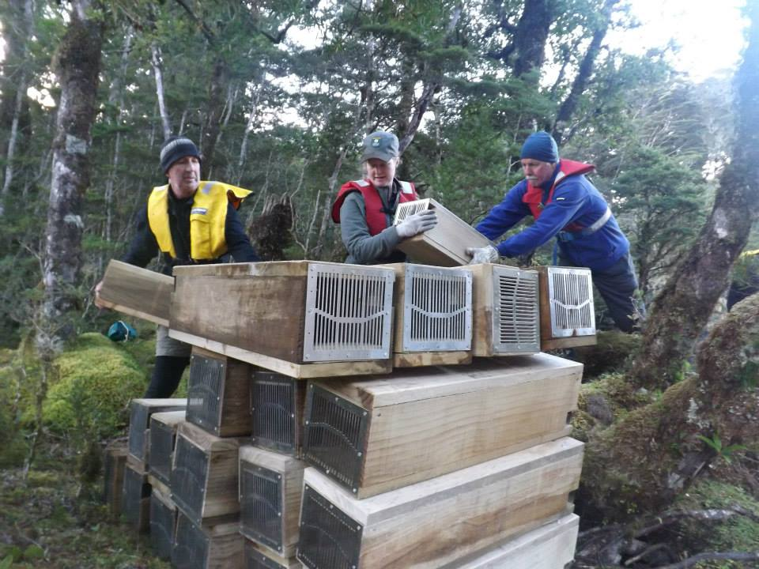
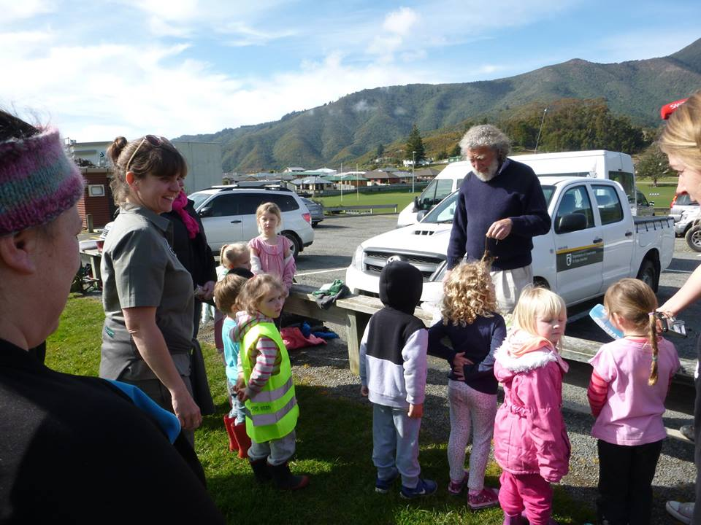
Community – you can’t stop this groundswell!

Slide 17
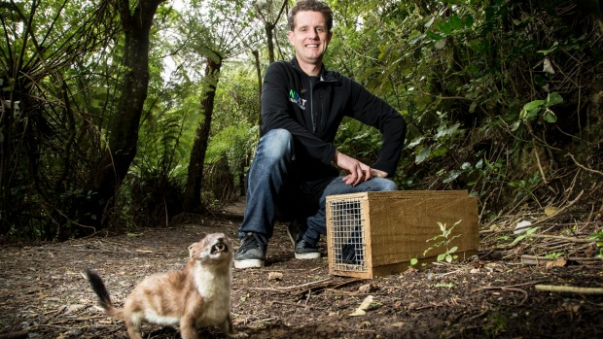
The power of community champions

Slide 18
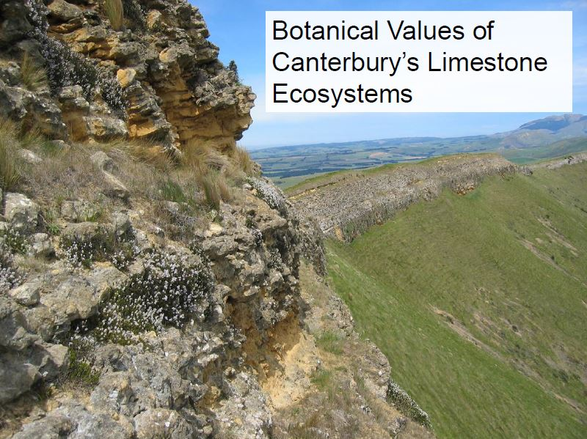

Slide 20
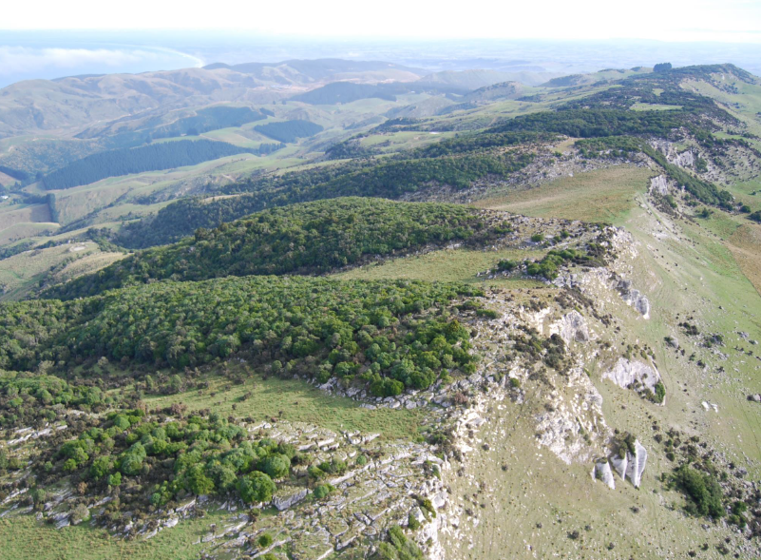

Slide 21
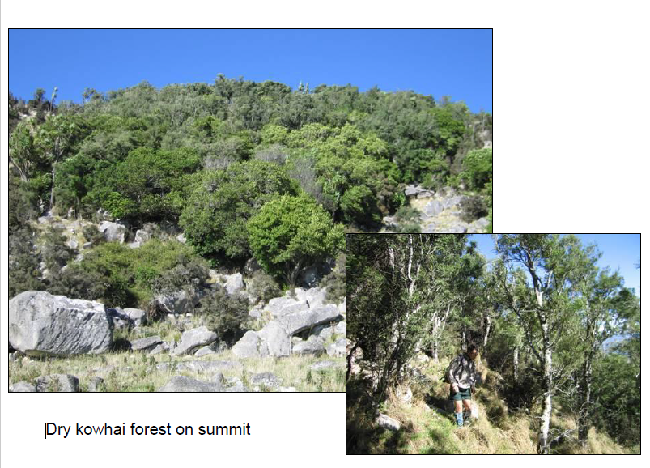

Slide 22
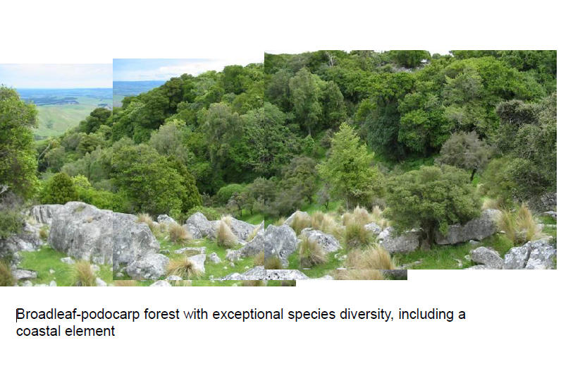

Slide 23
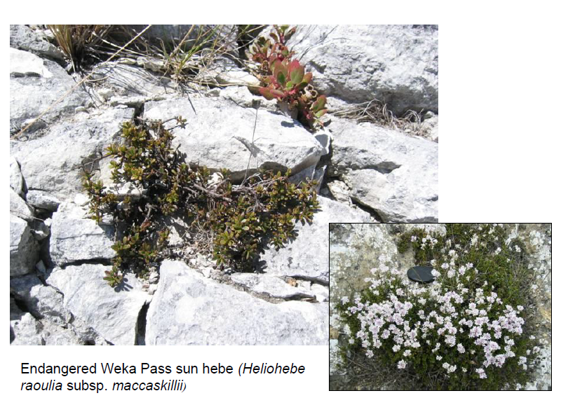

Slide 24
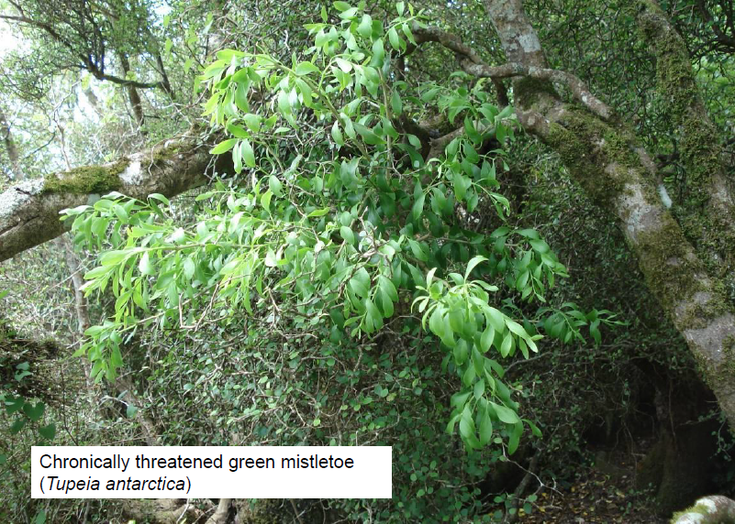

Slide 25
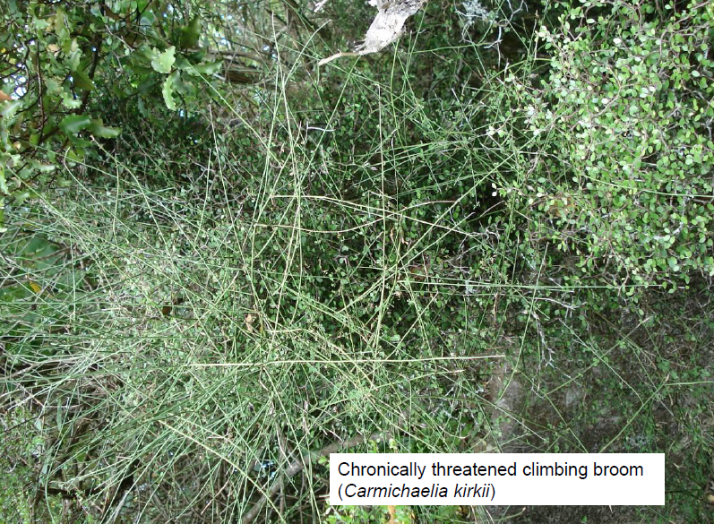

Slide 26
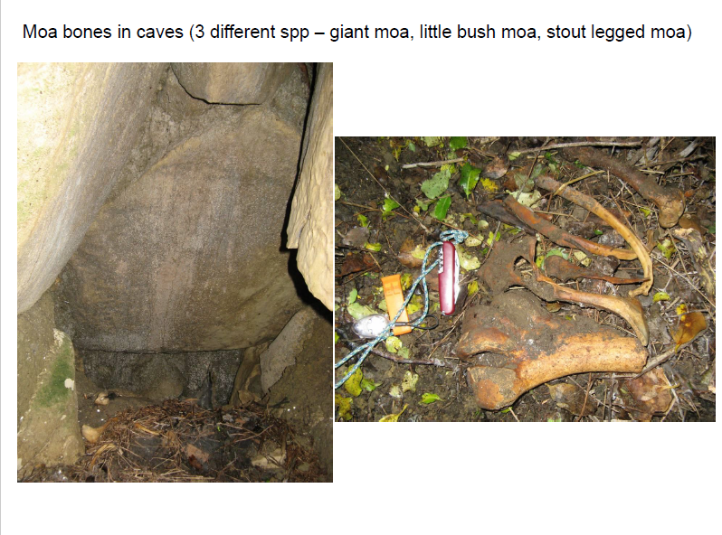

Slide 27
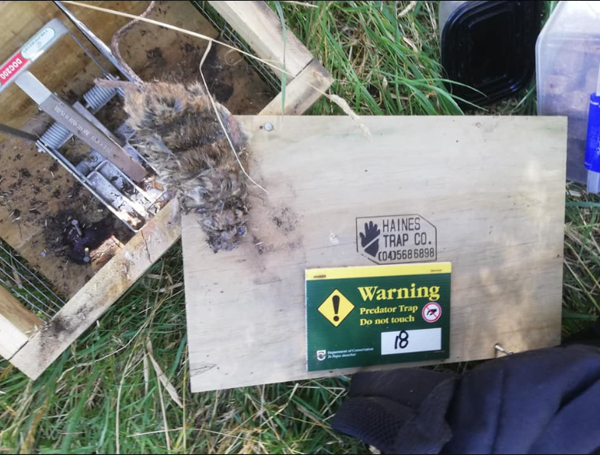
Waipara Environmental Trapping Association (WETA!)

Slide 28
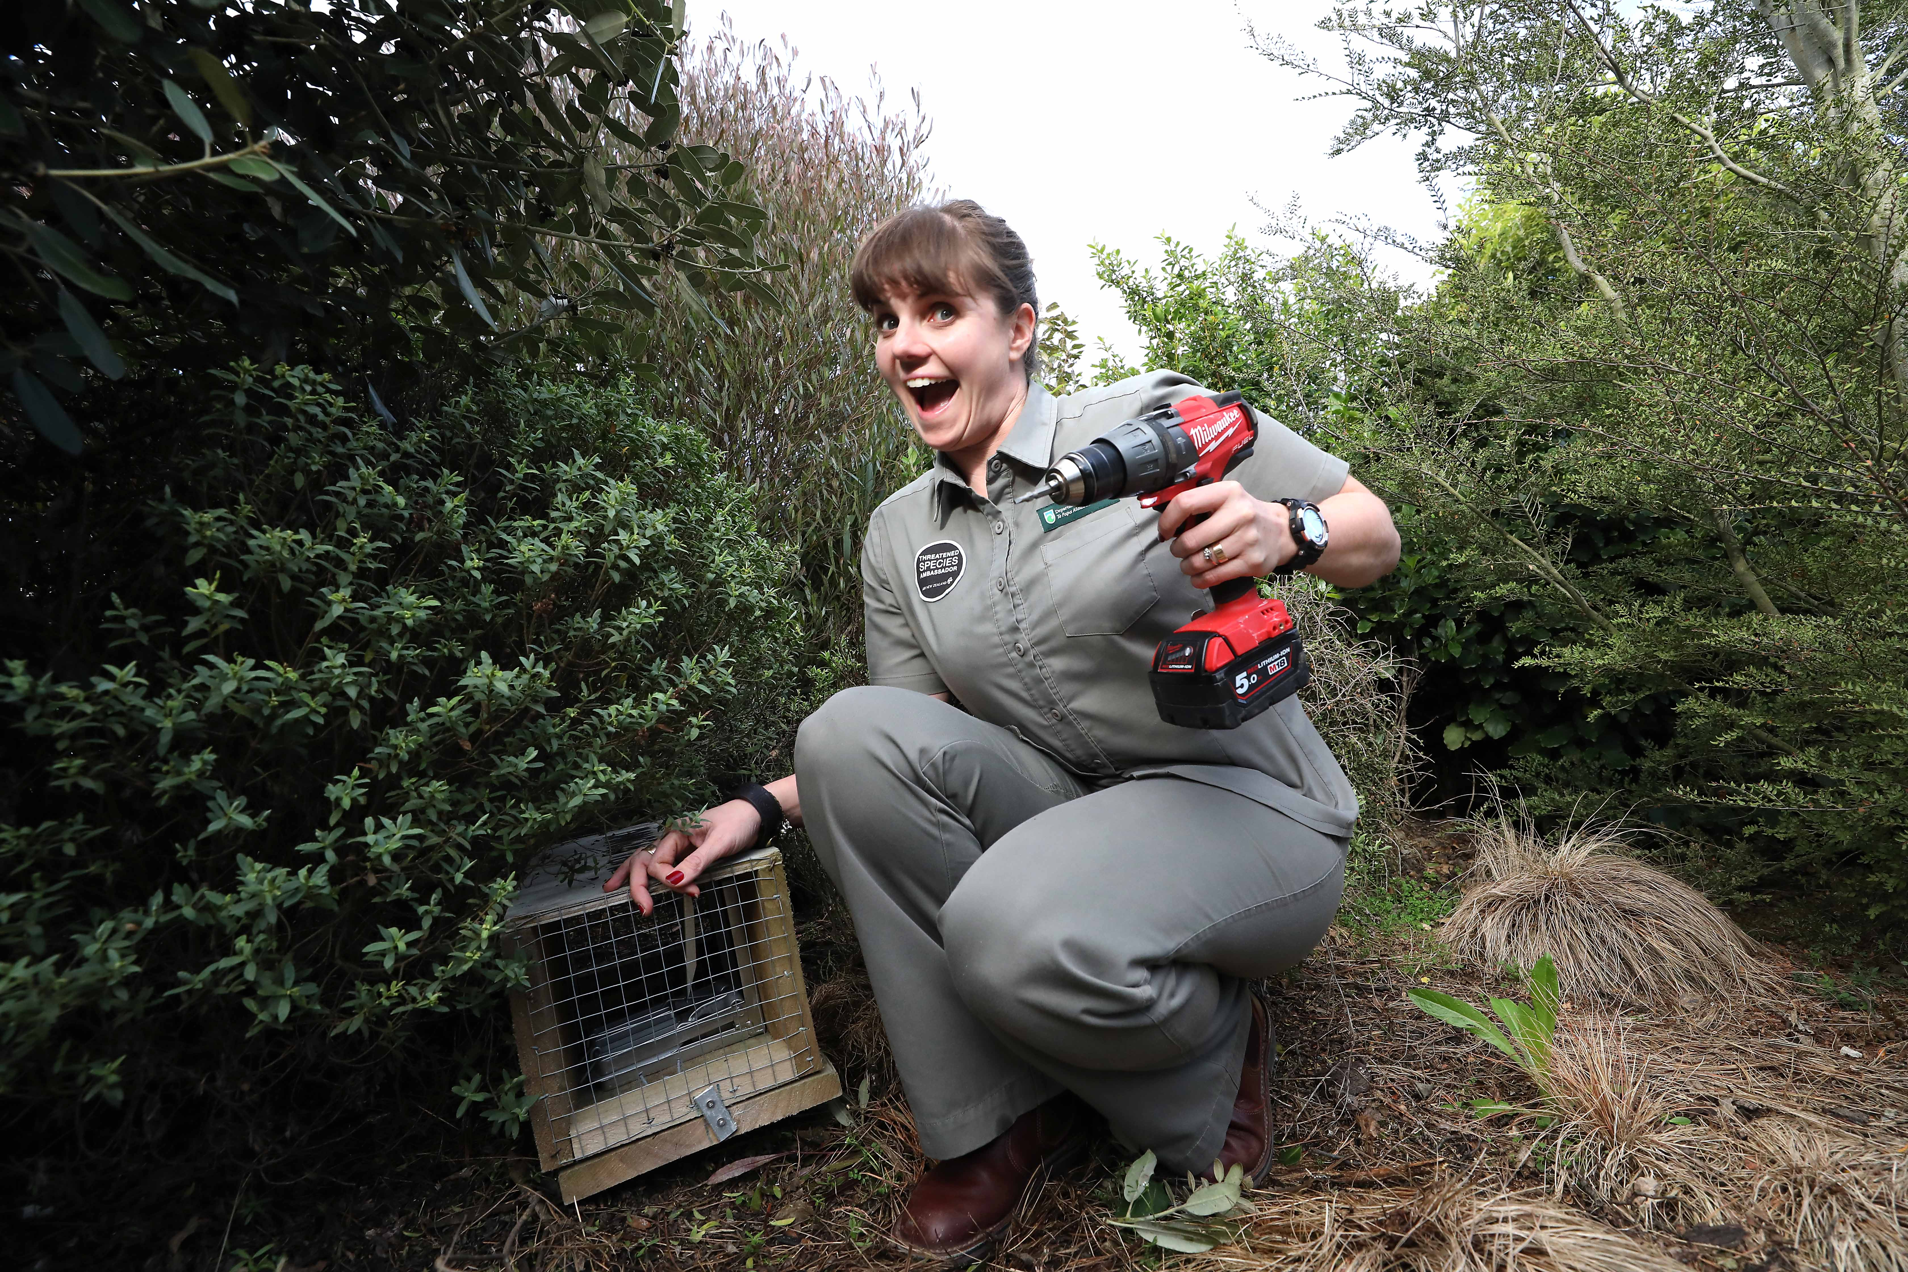
Who’s keen to join?!

Slide 29
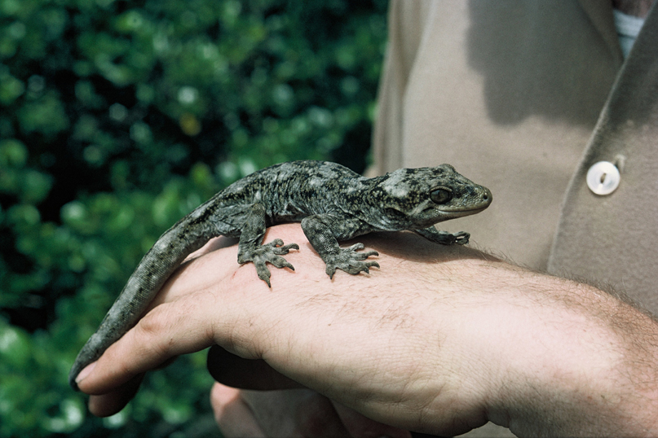
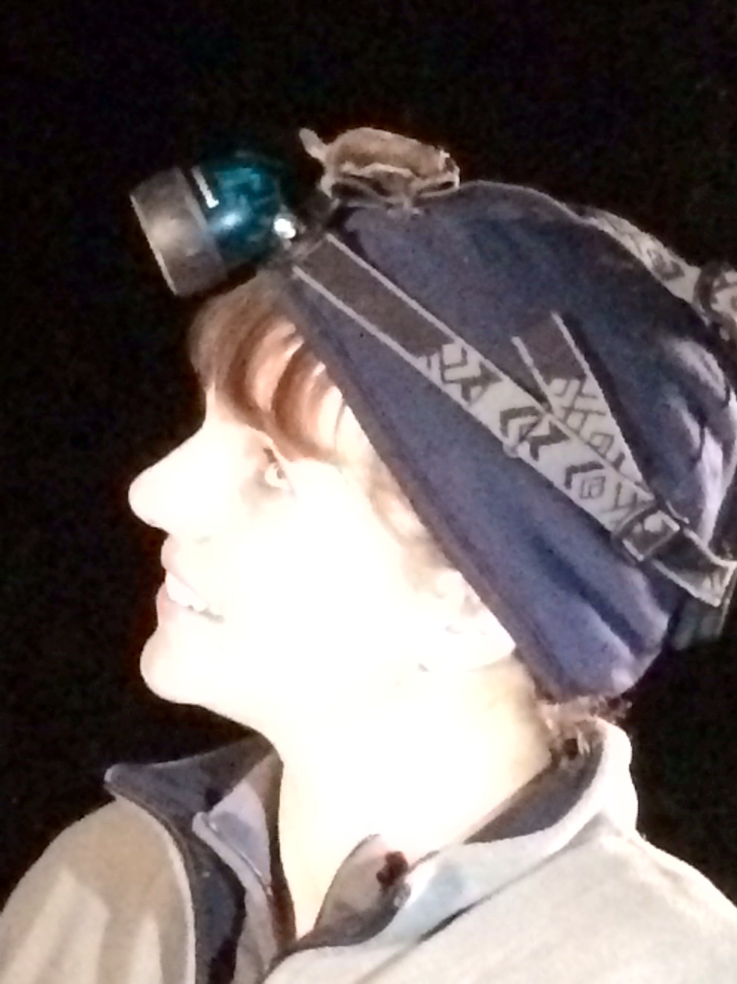
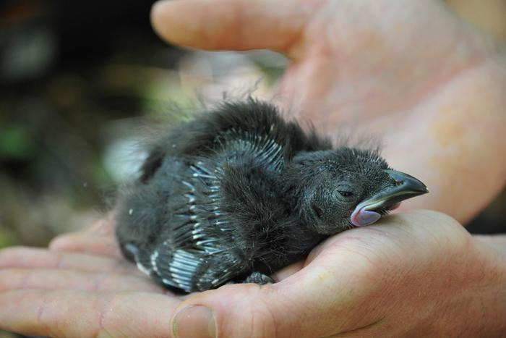
Our motivation…
“They are our national monuments. They are our Tower of London, our Arc de Triomphe, our pyramids. We don’t have this ancient architecture that we can be proud of and swoon over in wonder, but what we do have is something that is far, far older than that. No one else has kiwi, no one else has kakapo. They have been around for millions of years, if not thousands of millions of years. And once they are gone, they are gone forever. And it’s up to us to make sure they never die out.” – Don Merton

