Slide 1
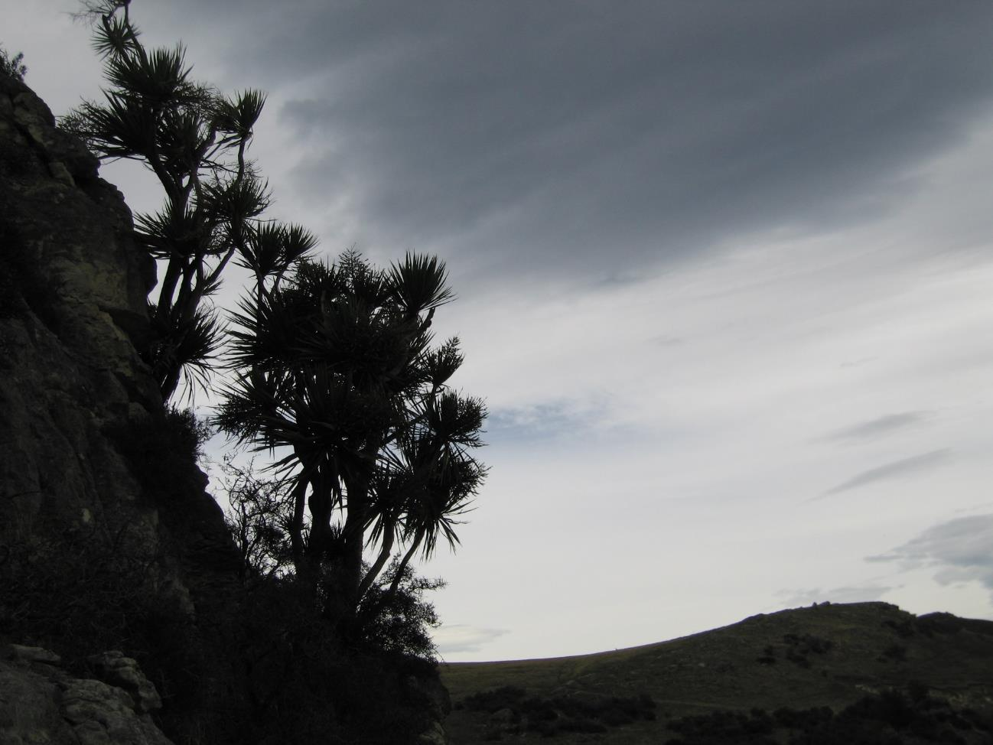
Vegetation
and plants
that define
The Hurunui

Slide 2
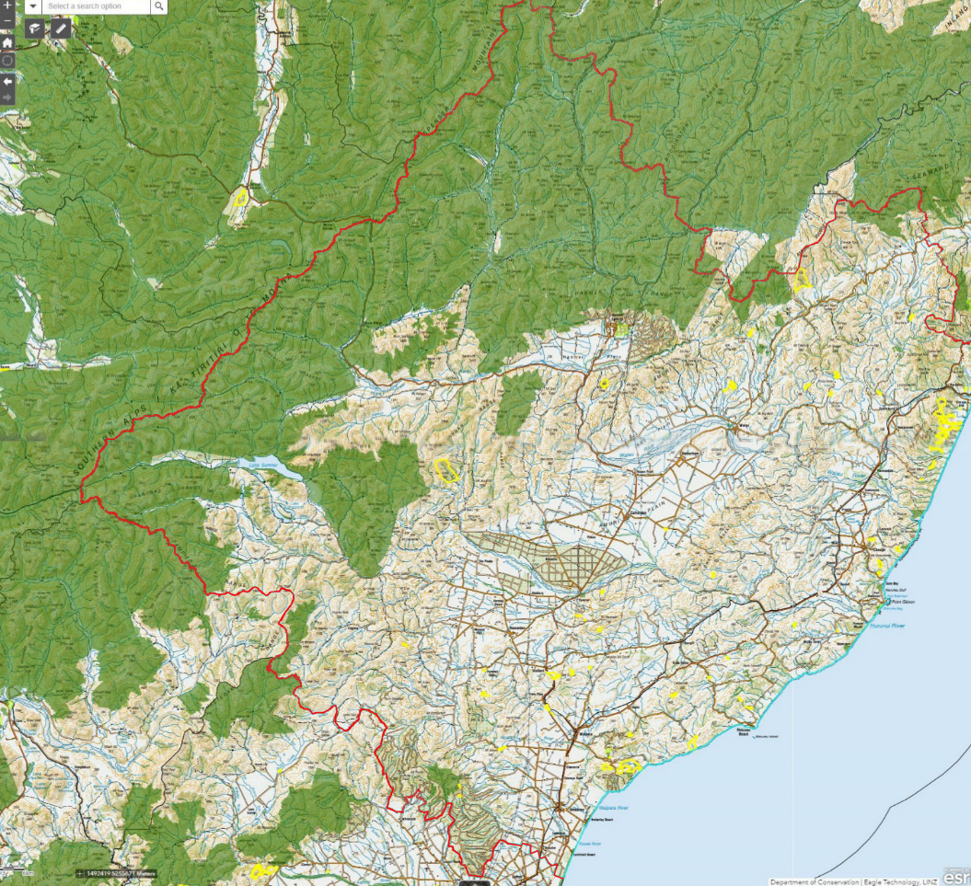
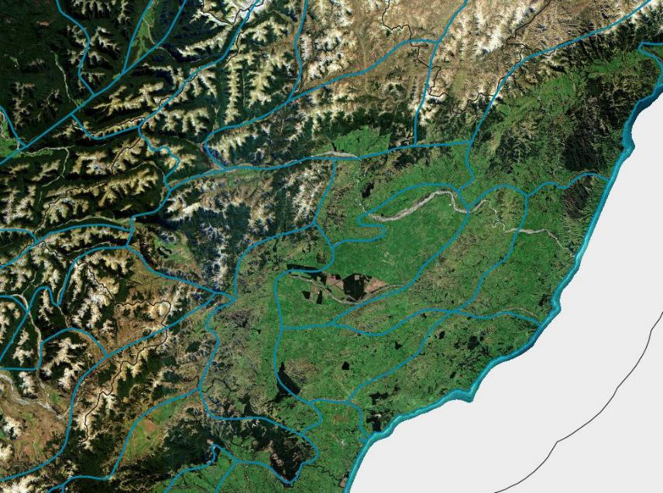
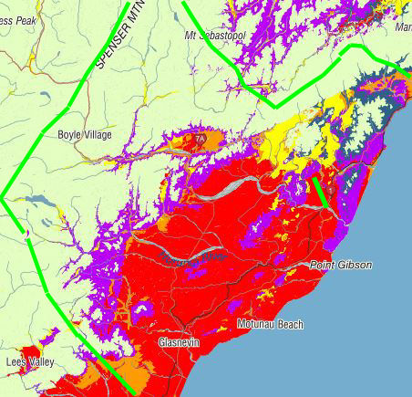
Big: 8,641 km2
Diverse: 8 Ecological Regions, 20 Ecological District
Eastern area <10% indigenous cover, covenants
Notes:
Environmental gadients – coastal to inland, latitude, altitude, inland basin climate, rainfall gradient, wind, greywcke- tertiary, disturbance
Ashburton 3183 km2 4 ER 10 ED, 40 bigger
2

Slide 3
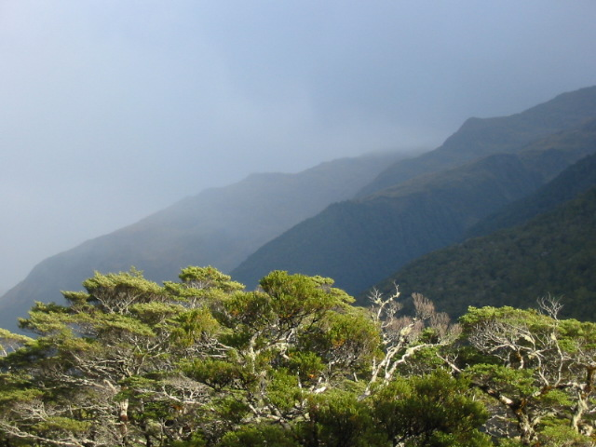
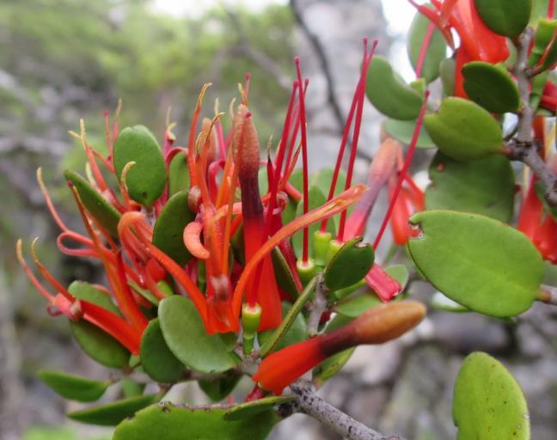
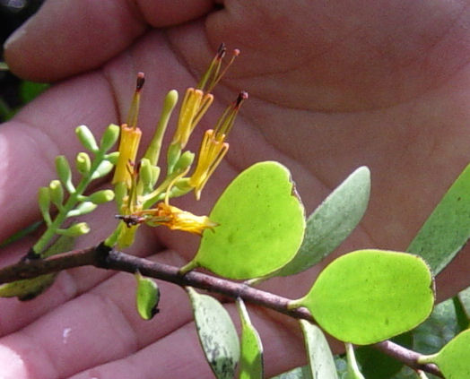
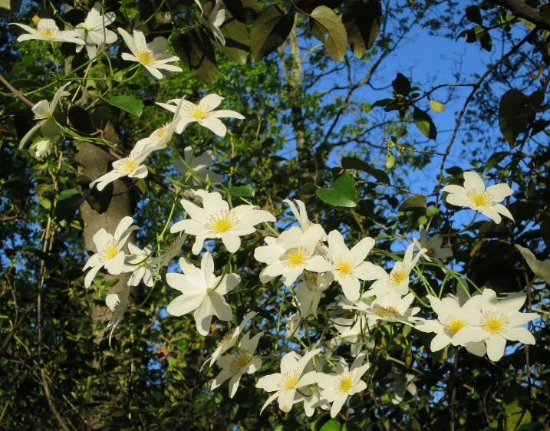
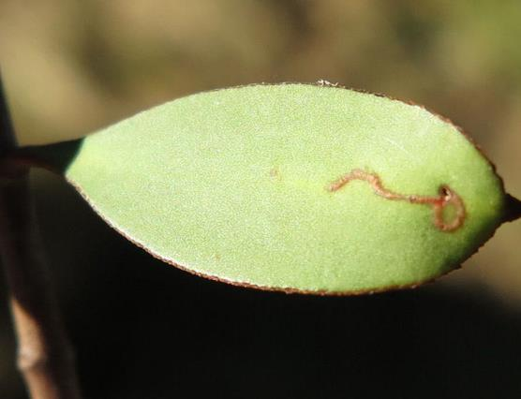
Mountain beech forest
Notes:
Beech forest, well covered by Lake Sumner Forest park, Lewis Pass scenic reserve, St James Conservation area, Nina Doubtful Rivers, Hamner Forest park, Woodbank forest reserve, The Den and Seaward Forest, Lochiel Conservation area, Snowdon and Tinline Conservation areas, Terako Downs and Lottery Bush, Wandle Bush, and Wairangi scenic reserve, Mt Grey/Maukatere. That is about 280,000 hectares.
3

Slide 4
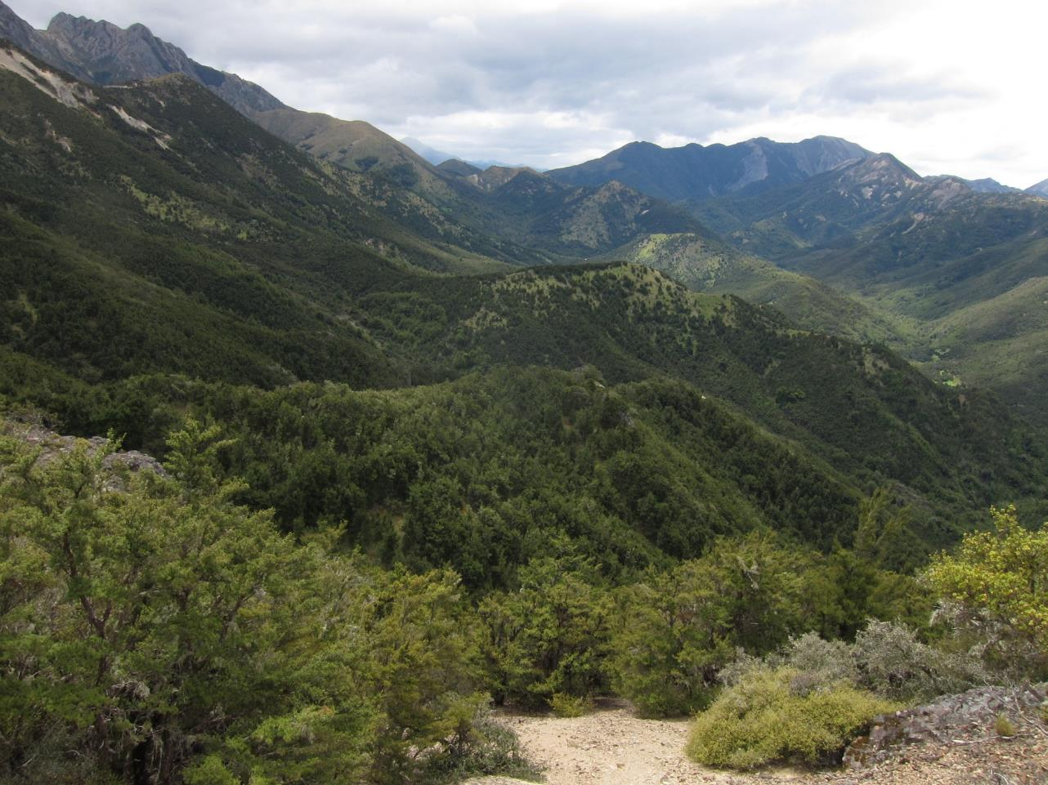
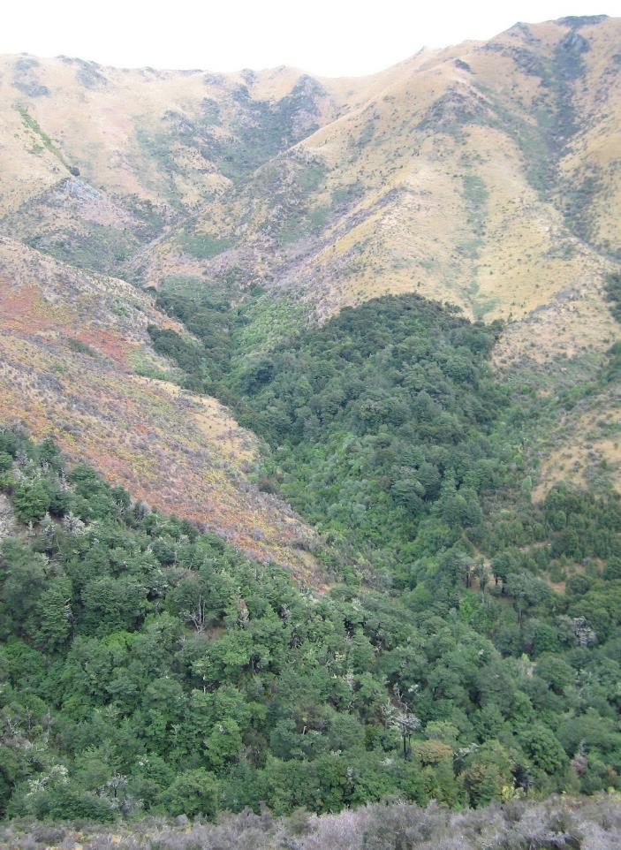
Bracken-grey scrub-kanuka succession
back to mountain beech forest
Notes:
Succession to beech forest
4

Slide 5
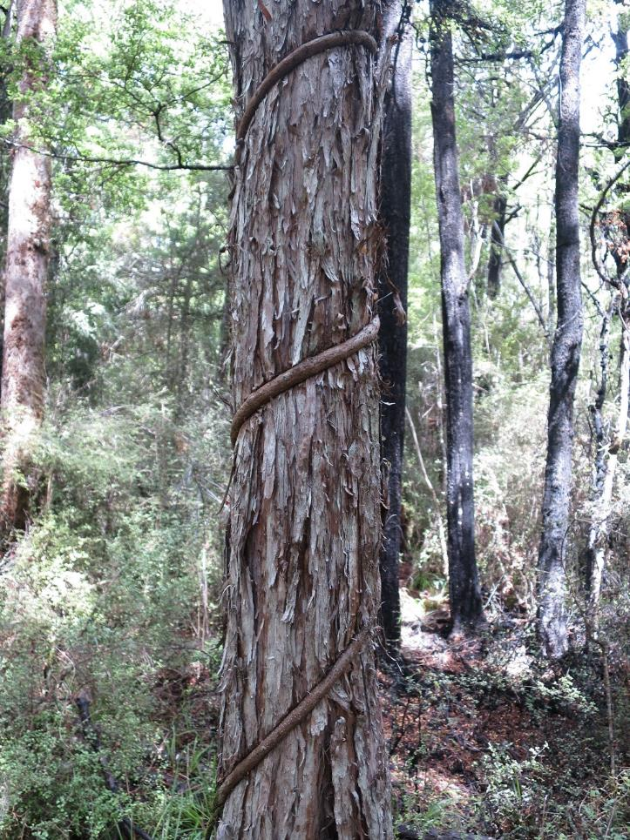
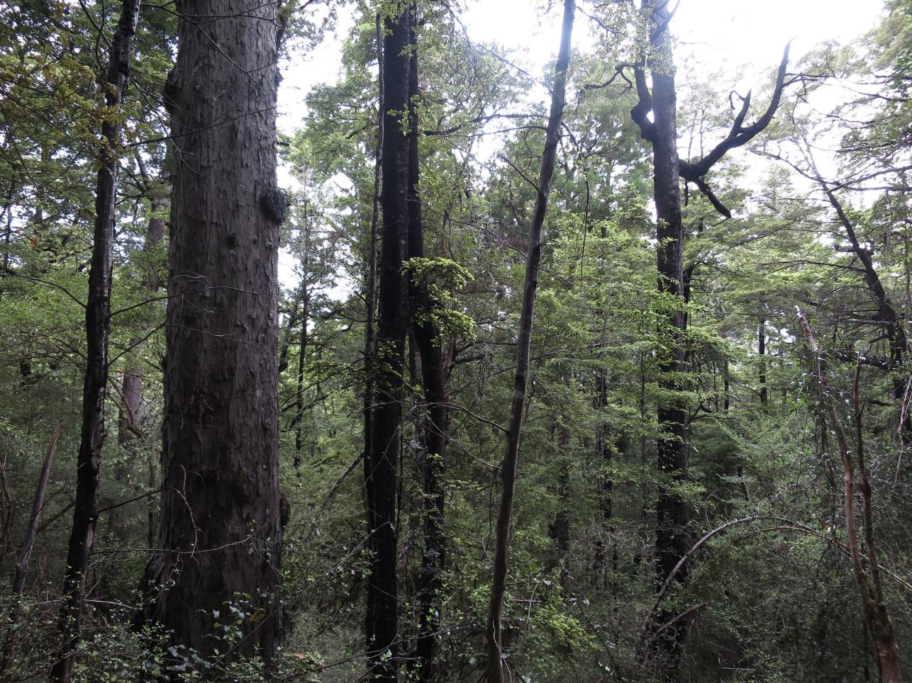
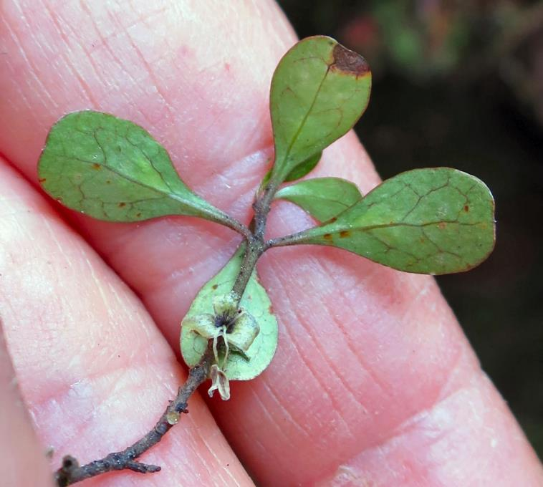
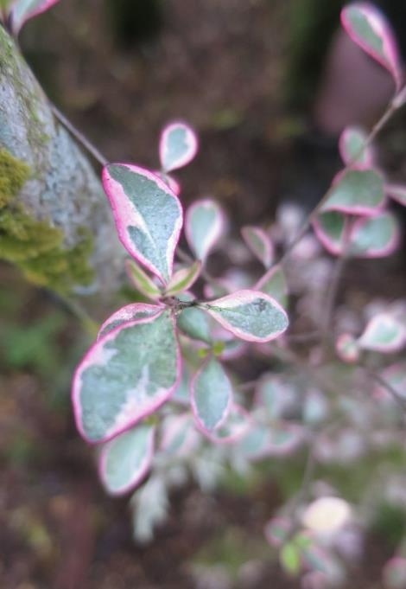
Mountain beech forest with matai, totara, kahikatea, rimu and groves of a rare mikimiki shrub.
Notes:
Lottery bush, Wandle Bush and Trako Downs mountain beech, matai, impeded drainage Coprosma pedicellata
5

Slide 6
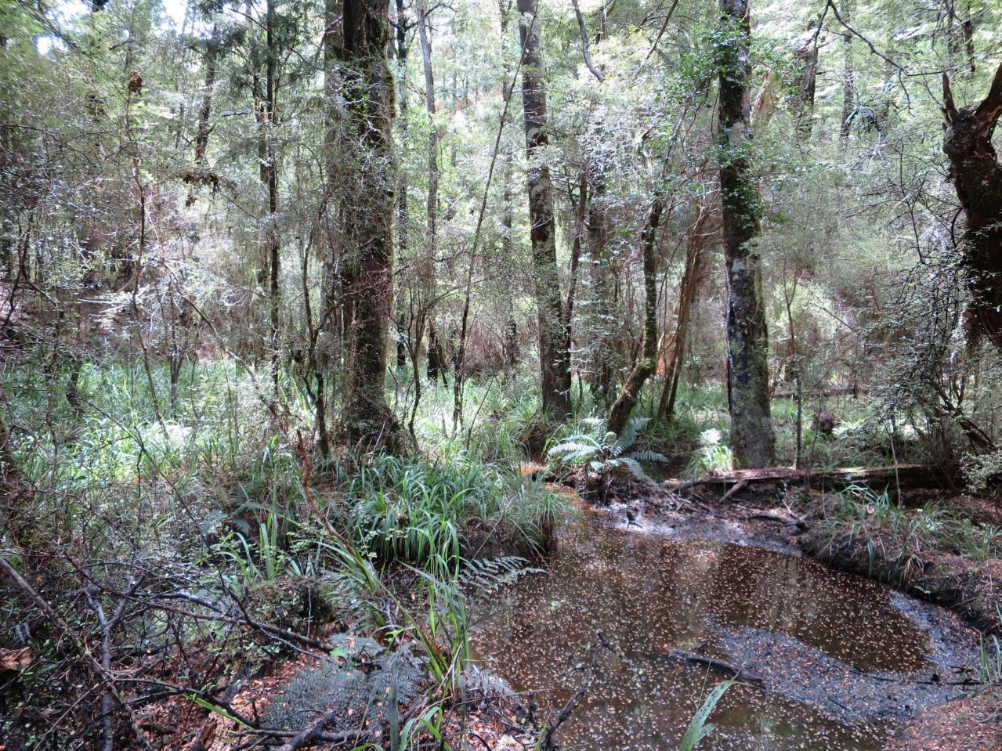
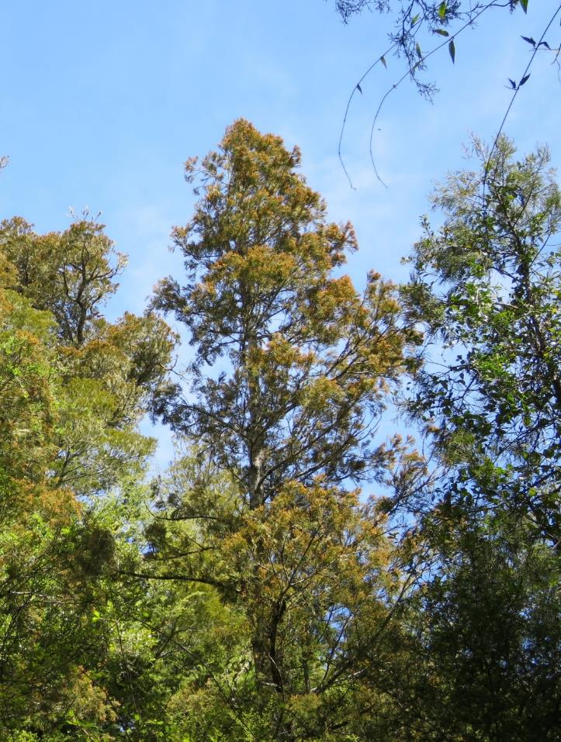
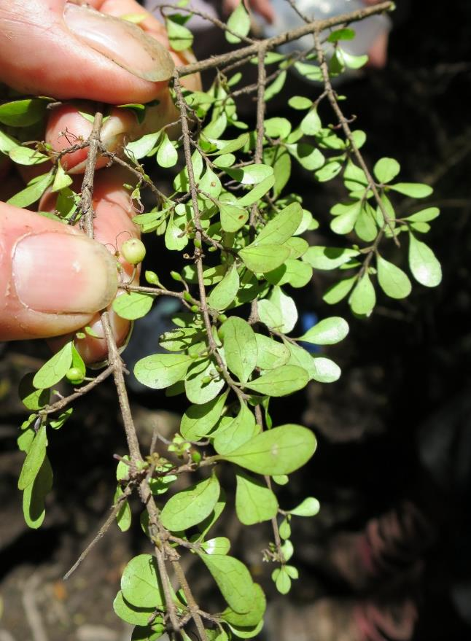
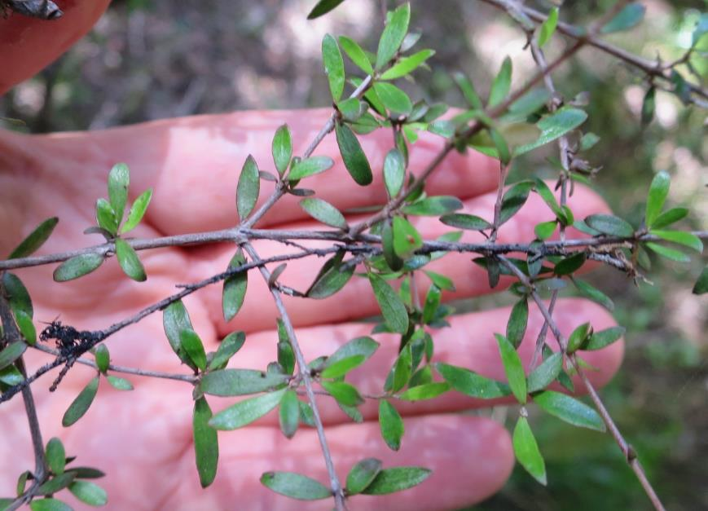
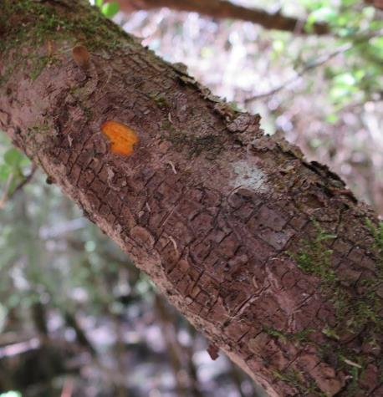
Red and mountain beech with matai, totara, kahikatea and two rare mikimiki shrubs.
Notes:
Ngaroma reserve Mountain beech, matai, totara, kahikatea, and two rare coprosma ped and Cop obconica.
6

Slide 7
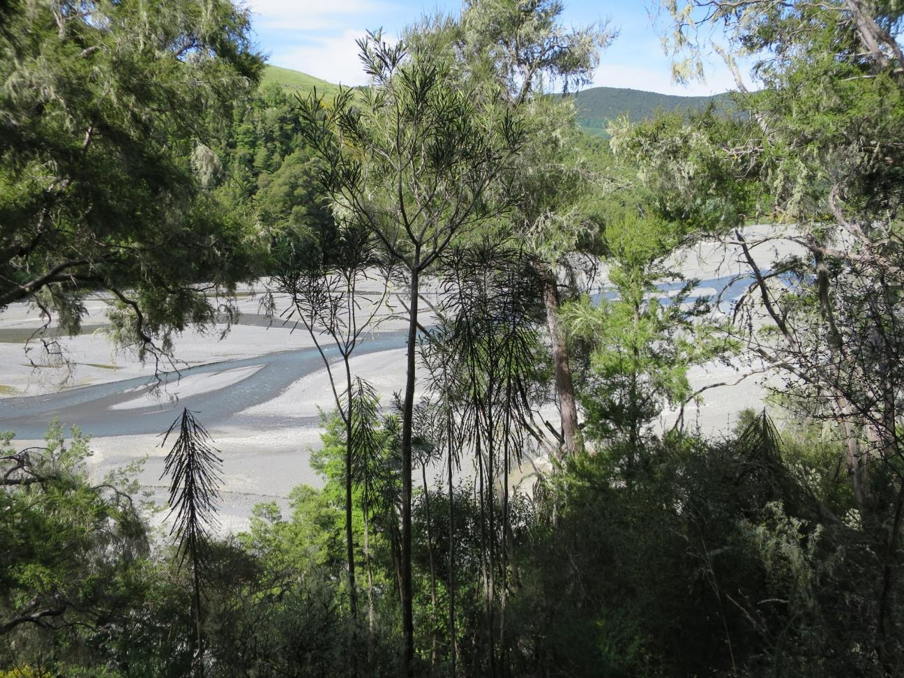
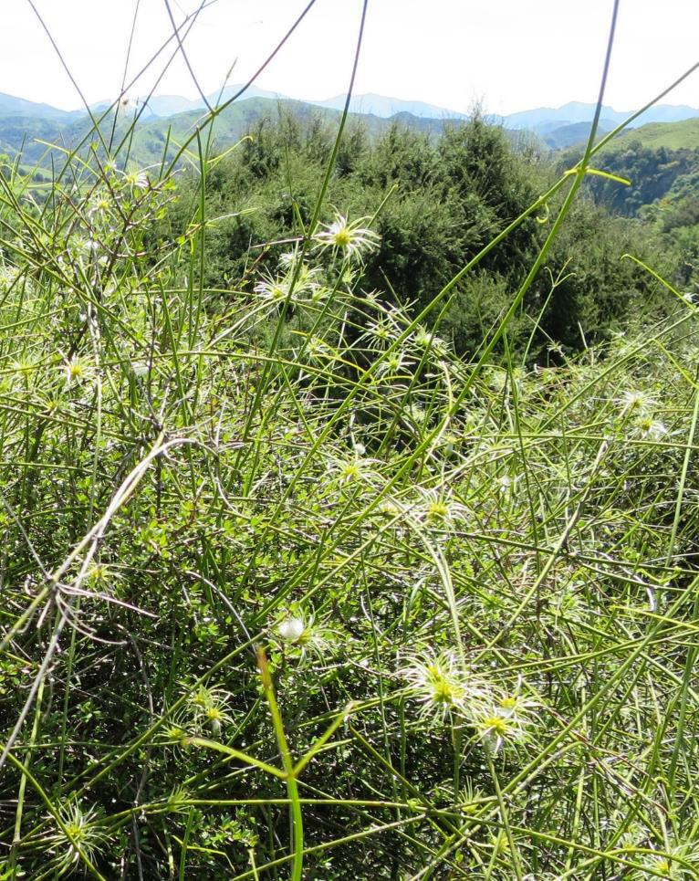
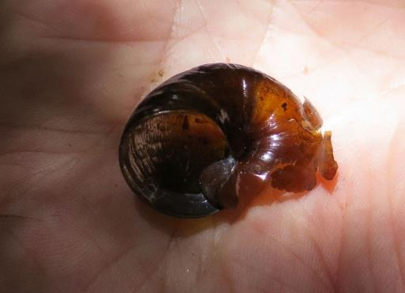
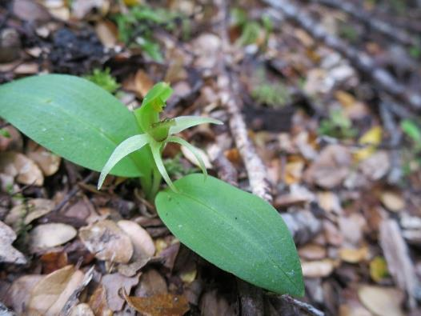
Fierce lancewood-kanuka-kowhai and dryland shrubland
Notes:
Ngaroma Conway river terrace
7

Slide 8
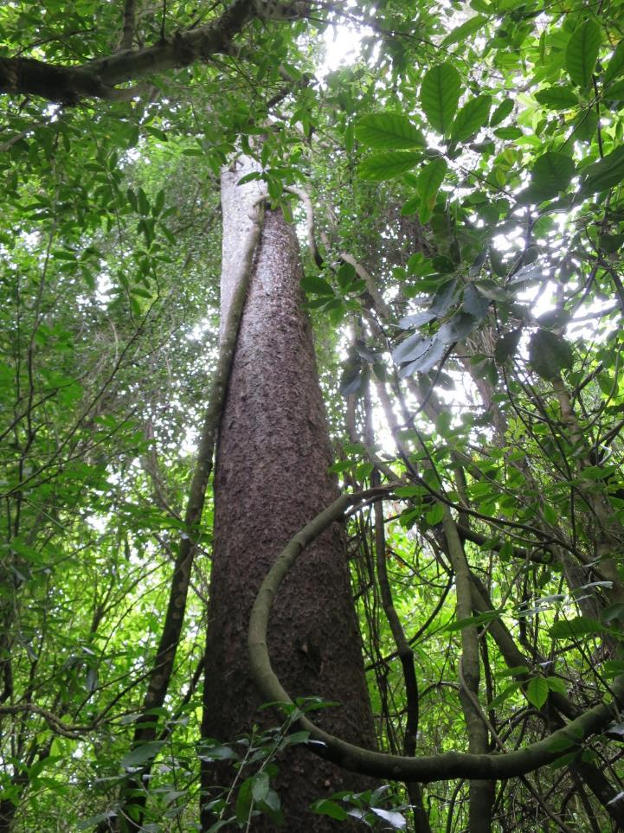
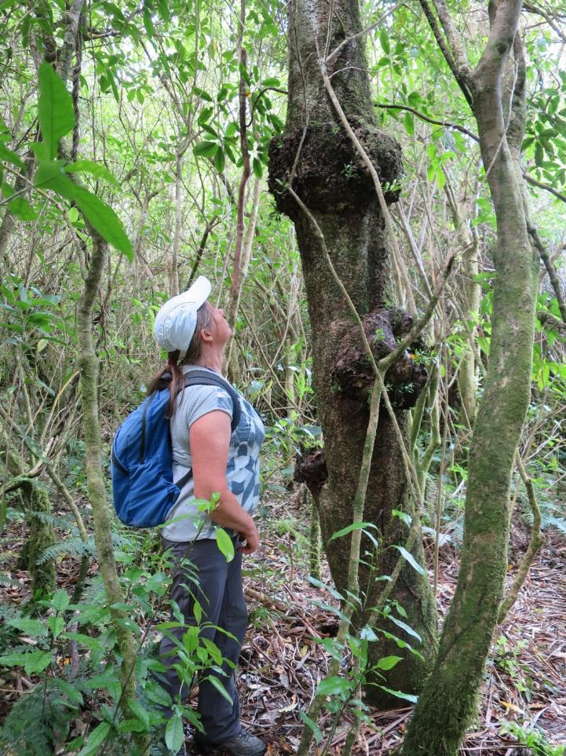
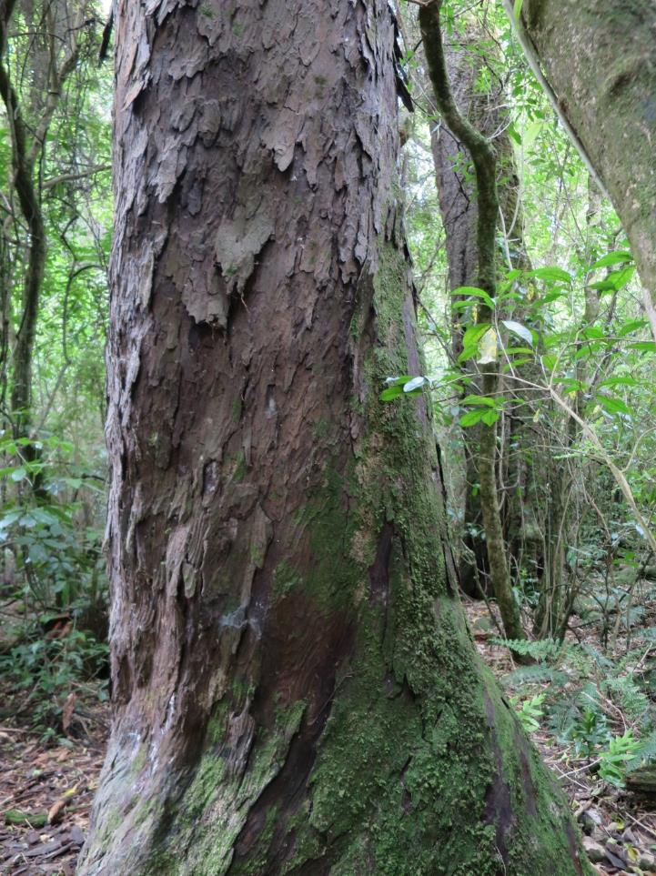
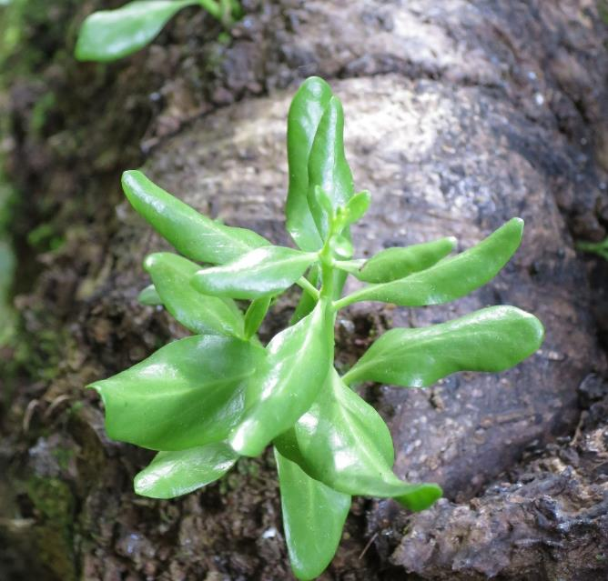
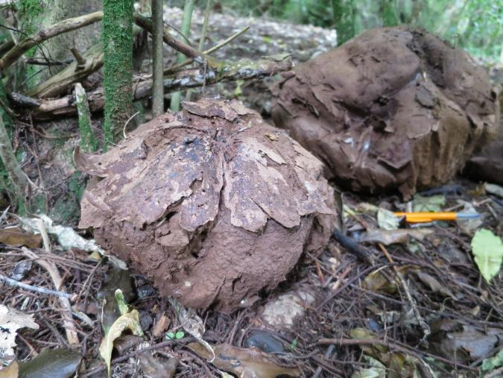
Climate and soils can grow podocarp forest
Notes:
Ferniehurst Richard Wilding, 5 podocarps, red beech, hinau, enormous clinbers – kohia, bush lawyers, climbing fuchsia, Calvatia lilacina puffballs. Tupeia mistletoe.
8

Slide 9
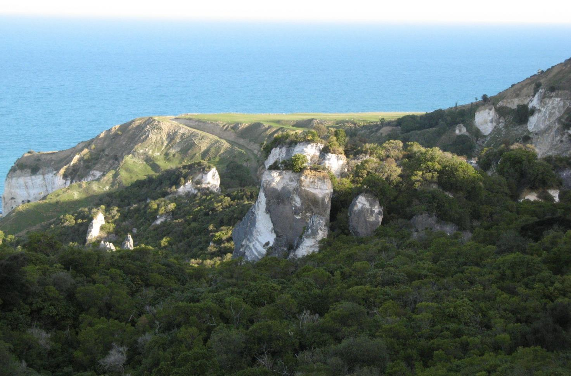
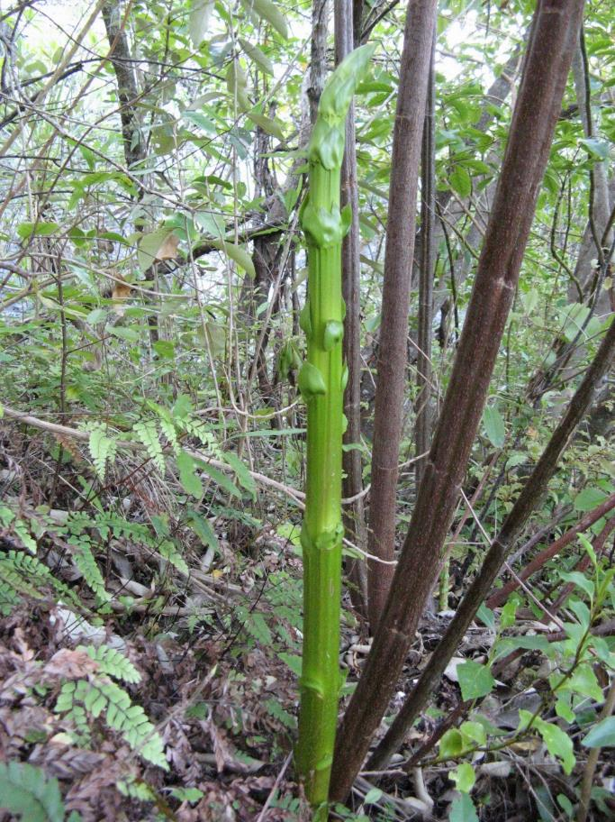
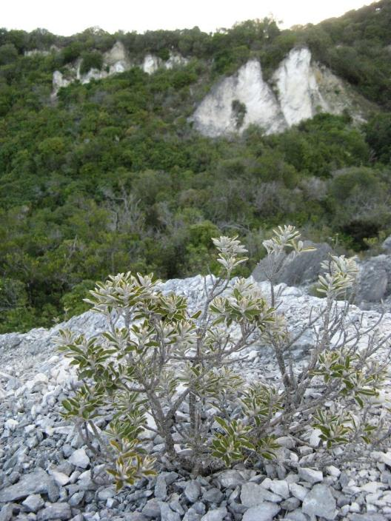
Coastal (totara)-Broadleaf limestone forest
Notes:
Napenape
9

Slide 10
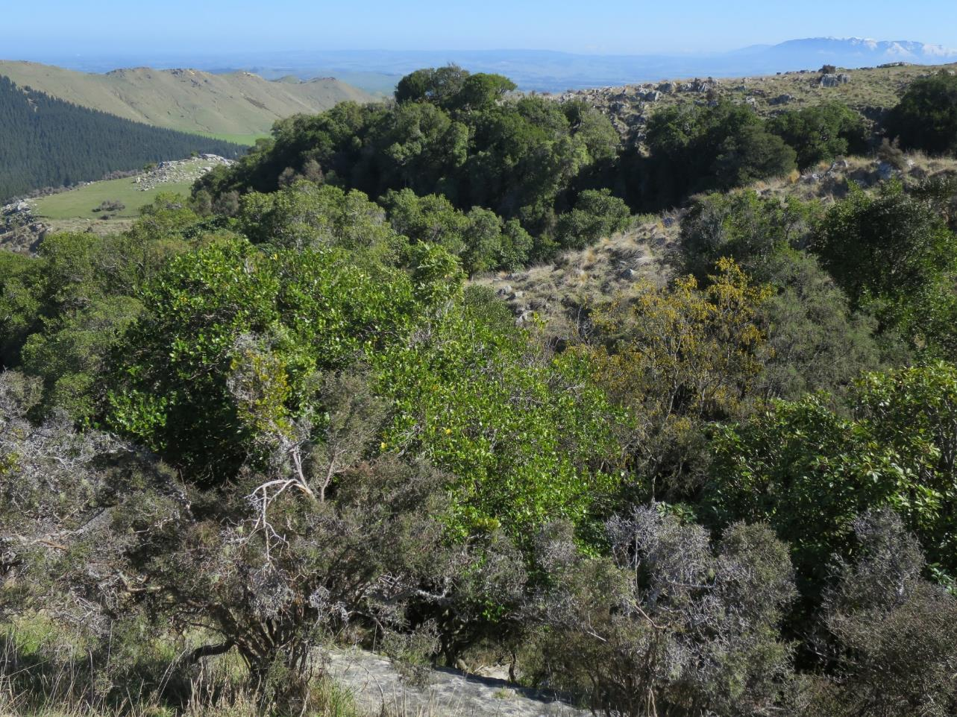
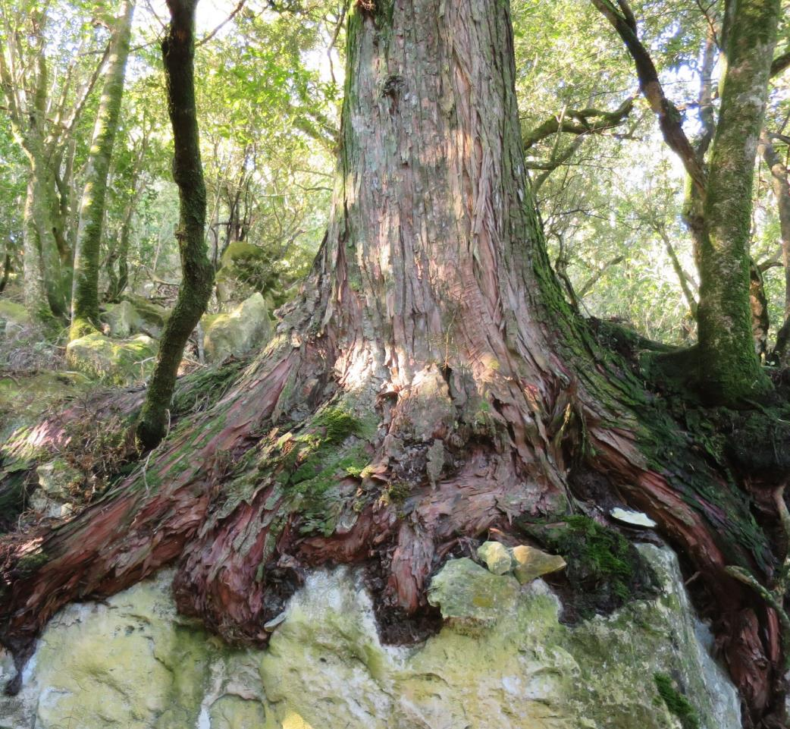
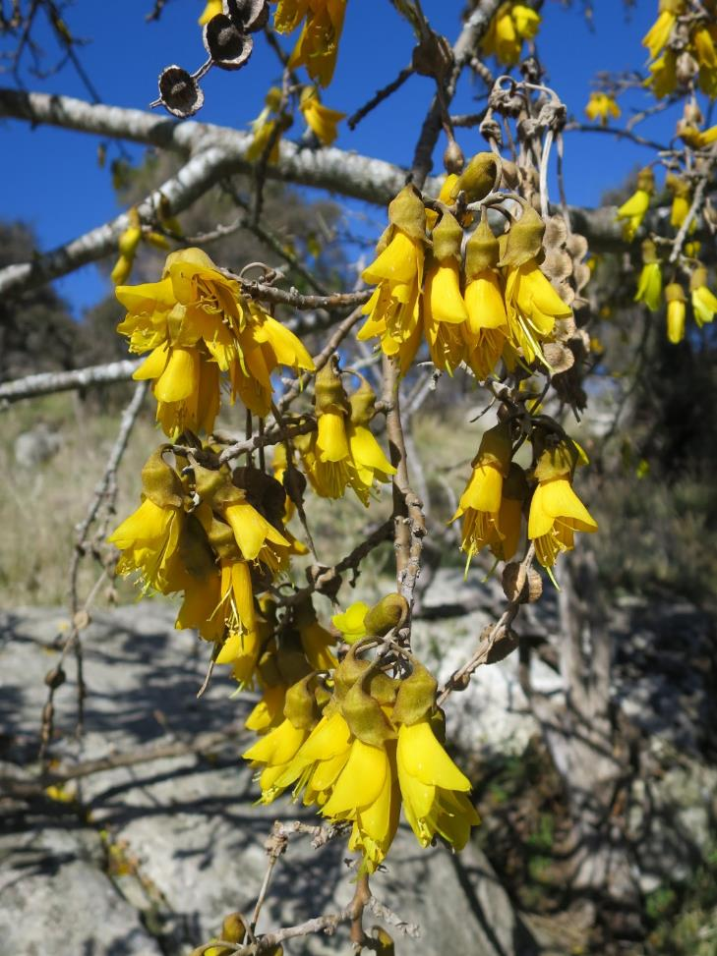
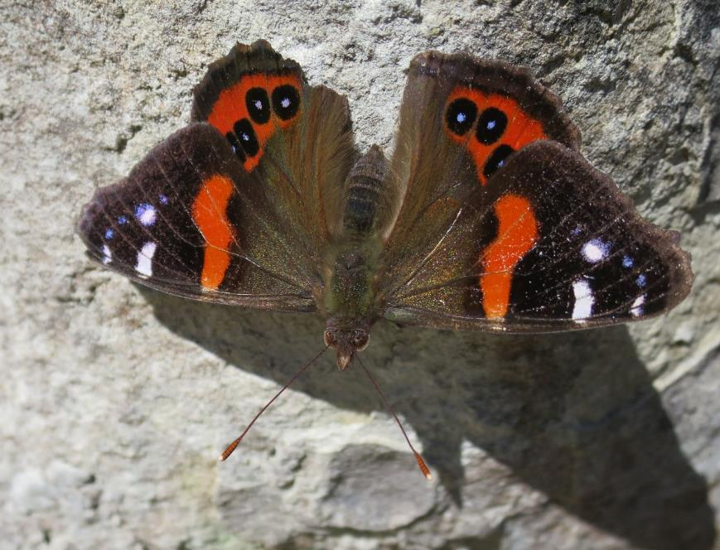
Podocarp-broadleaf limestone forest and species –rich shrubland
Notes:
Limestone. The limestone ranges define the Hurunui – Waipara Gorge, Claremont, Weka Pass, Timpendene, Pyramid valley, The Deans, Mt Brown, Mt Cass, Mt Vulcan, Mt Donald, The Omihi hills, Monserrat earth flow, the Coringa earthflow, Waingaro, Isolated Hill, Mouse point, and Mt Cookson. The Hurunui has a shrub found only within 15 km of Weka pass. It has its own gentian.
10

Slide 11
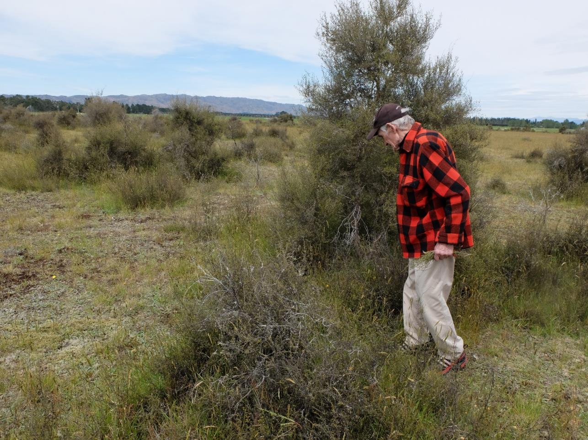
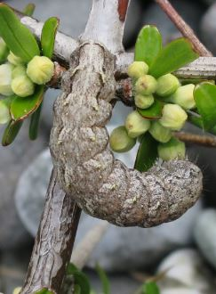
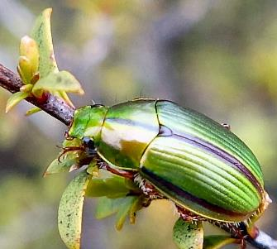
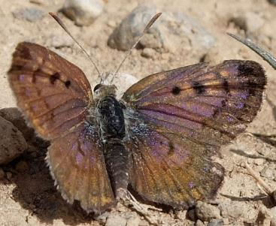
Low stature kanuka forest
Notes:
The cold, frosty, well-drained gravel soils inland basins may be supported patches of beech-totara forest – Amuri plains, Emu plains, Hamner plains had a mix of low, open kanuka forest, matagouri shrublands, silver tussock and short mat vegetation. This was easily cleared by fire, then rabbits, then the “worst” land planted in pines in the 1920’s. Medbury and Culverden scientific reserves are precious relicts that hold onto the plants and insects. Here is the very rare matagouri moth in Culverden reserve. 2.6 ha Bankside reserve had 66 specie sin 1970, now only 26 native species and 26 new exotic species. But it has held onto its insects and worms.
11

Slide 12
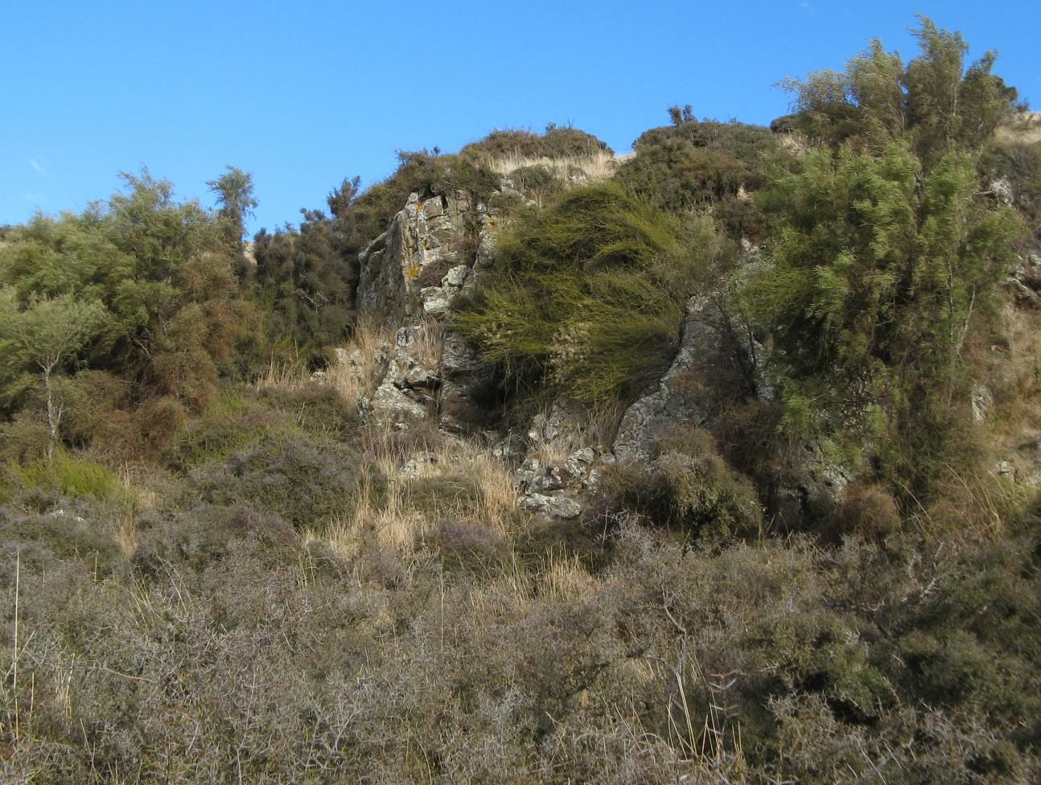
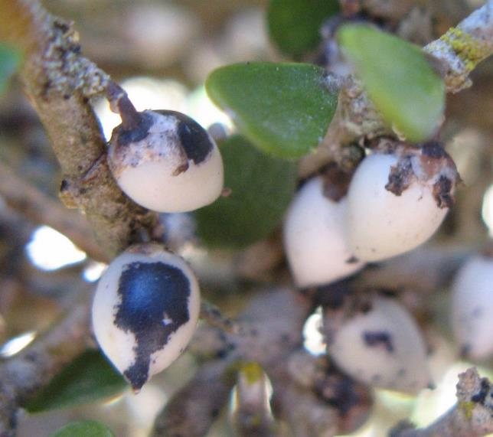
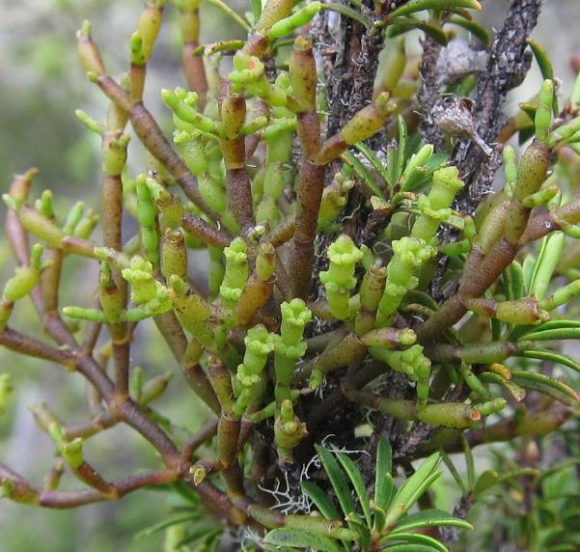
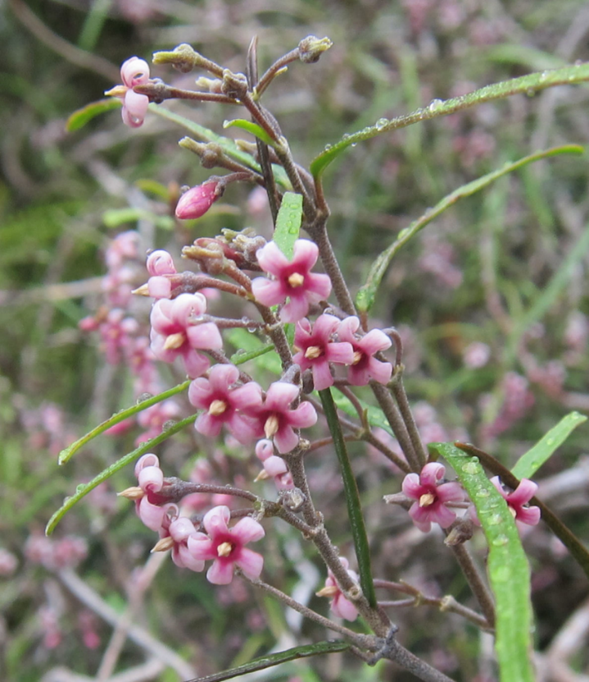
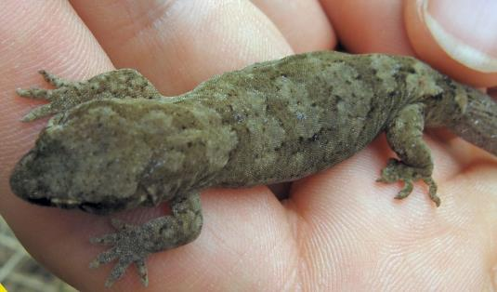
Natural shrublands
Notes:
shrubland
12

Slide 13
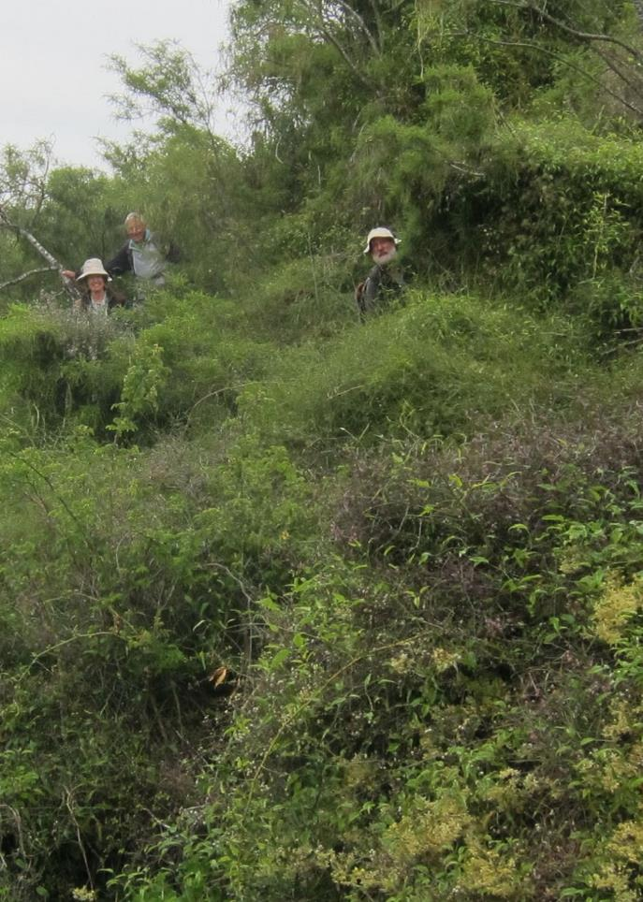
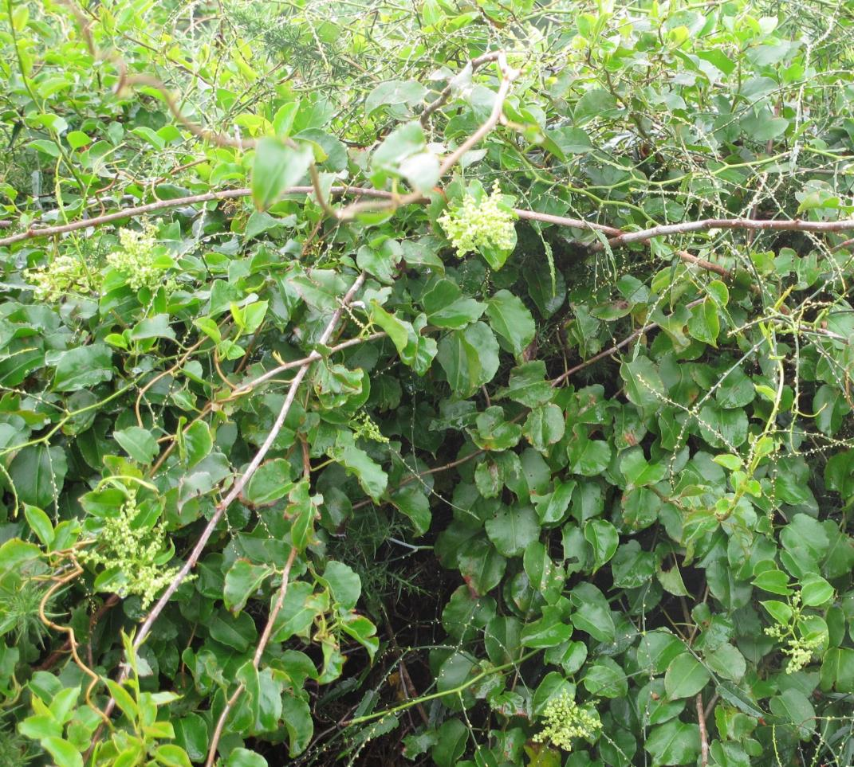
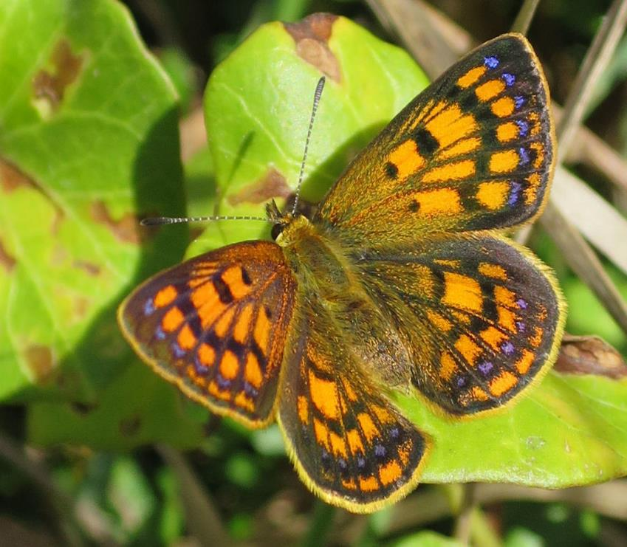
Vinelands
Notes:
Undescribed species in the Common Copper group, probably the Canterbury Copper. Lycaena. Lowcliff. Male.
13

Slide 14
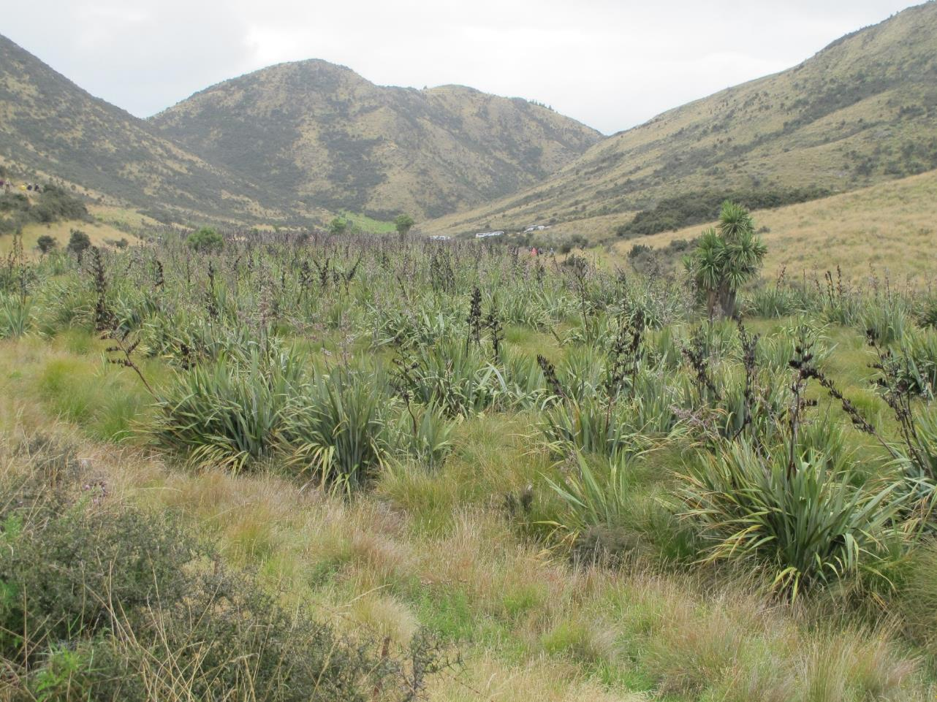
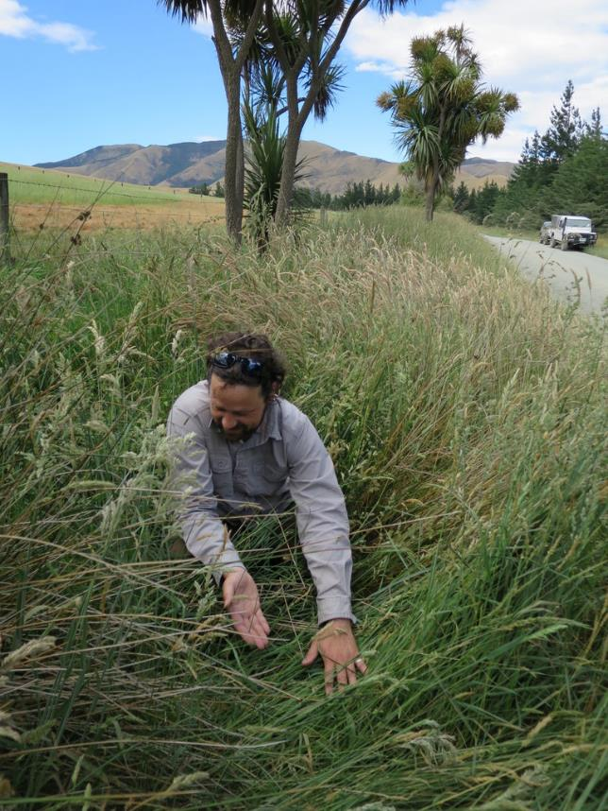
Valley-floor harakeke-pukio wetlands
Notes:
Kit Pawsey QEII trust wetland on an open day. Lepidosperma australe on Ram paddock Road
14

Slide 16
Waipara, Motunau, Blythe, Hurunui, Jed, Waiau, Conway, Okarahia riverbeds, river margins, river gorge outcrops, hinarepe sand tussock.

Slide 17
Mt Ararat reserve – southern rata, manuka on sandstone

Slide 18
Waipara Conservation area
Notes:
The Eastern ranges – Doctors Hills, Lowry, Omihi, the home of low forest and shrubland. Here the tenacious wiggywig hangs on.
18

Slide 19
Hurunui Naturally Uncommon ecosystems
Contain a disproportionate number of threatened plant species
Limestone cliffs, scarps, tors, screes, boulderfields,
caves, pavements, and karst.
Gravel beaches
Braided rivers
Alpine screes, moraines, snow banks
Wetlands estuaries, lake margins, seepages and
flushes, cushion bogs, ephemeral wetlands
https://www.landcareresearch.co.nz/publications/factsheets/rare-ecosystems

Slide 20
Plant threat list published in 2018
Kauri dieback and Myrtle rust added kanuka, manuka, pohutukawa, rata, rohutu, and the kanuka mistletoe to the threat list.
“A noticeable deterioration in populations of plants of eastern South Island drylands (e.g. the sedge Carex albula, the Maniototo peppercress Lepidium solandri, and several broom species including Carmichaelia torulosa, which is now assessed as Threatened – Nationally Critical) continues a worrying trend that was noted in 2009”.
The “extinct” montane tarn edge fathen appeared in Molesworth, Heron basin and the Mackenzie in 2015, after 56 years.

Slide 21
Overview of NZ Limestone flora
Field work from 2004, published 2018
29% of the 153 limestone plant species ("calcicoles") are ranked as Threatened- Nationally Critical, the highest threat rank possible.
Only 5% are considered not threatened.
Small areas of limestone outcrops are home to tiny populations of distinct plant species.
21 of 41 taxa (68%) of the South Marlborough-North Canterbury limestone plant species are Data-deficient or threatened.
There is no research on how to manage limestone vegetation. The worst weed is red fescue.
Notes:
Small, isolated populations have been taken to the brink of extinction by the loss of their original vegetation structure, land clearance, invasive weeds, and disappearance of their lizard and bird seed-dispersers. DOC held one meeting in March 2017 to discuss a recovery group for Eastern South Island Limestone.
Dr Peter Heenan, Wildlands Consultants, undertook to write a field guide.
21

Slide 22
150 plant species classified as Threatened or At Risk.
3 | Locally Extinct
8 | Threatened-Nationally Critical
13 | Threatened - Nationally Endangered
22 | Threatened - Nationally Vulnerable
61 | At Risk- Declining
39 | At Risk- Naturally Uncommon
1 | At Risk- Recovering
2 | At Risk- Relict
9 | Data-deficient
159 | Total plant species
Mostly herbs, shrubs, grasses
10 | trees
20 | shrubs
4 | climbers
5 | mistletoes
84 | herbs
18 | grasses
10 | sedges
6 | rushes
2 | orchids
0 | lilies, monocot
2 | ferns
15% regional trend to a worse classification
Worse | 22
New listing
Better
Neutral
No change
Purposeful action
to hang onto
Habitat diversity
Species diversity
Genetic diversity
Notes:
The Department of Conservation revises the threat status of indigenous plants every 3 years (2008, 2011, 2014, 2017). A new listing was published in 2018. The assessment considers the number of plants, the number of sub-populations with more than 250 individuals, the total area of occupancy, and the trend in the population size.
The 2017 assessment took into account the potential impact of myrtle rust on the myrtle family – rata, pohutukawaka, manuka, kanuka, rohutu, and the kanuka dwarf mistletoe. These species were given a high threat classification based on the mortality of plants infected with myrtle species overseas. The authors emphasised that since the last assessment in 2015 there had been a noticeable deterioration in the threat ranks of plant species in the Eastern South Island. drylands Out of the 64 species that have moved to a worse category 16 occur in Ashburton region (25%).
22

Slide 23
Only in the Hurunui:
the Weka Pass gentian and Weka Pass sun hebe
Notes:
A view from further south.
23

Slide 24
Locally extinct
A grassland button daisy
A dune wetland gentian with yellow flowers
New Zealand Mouse-tail
A grassland daisy
Present in the Hurunui
Canterbury Pink broom
Waipara gentian
A limestone pimelea
A wetland grass
A willowherb
Threatened by myrtle rust
Rohutu – Lophomyrtus obcordata
Rohutu – Neomyrtus pedunculata
The pygmy kanuka mistletoe
Pimelea declivis
Rohutu Neomyrtus pedunculatus
The rarest of the rare: Nationally Critical threatened plant species
Notes:
A view from further south.
24

Slide 25
Southern limit: Marlborough rock-daisies around Leamington
Kiekie, kanono, black maire, climbing rata species, forest cabbage tree ti raukau north of the Conway river; Triangular fern at Coringa.
Notes:
25

Slide 26
Photo credit: Roy Veronese
16 Jan 2015, www.nzpcn.org.nz
Northern limits: Canterbury pink broom Carmichaelia torulosa roadside near Whalesback; Maori onion Bulbinella angustifolia at Lake Tennyson.

Slide 27
Photo credit:
Miles Giller
Eastern limit: Kamahi in beech forest at Lake Janet, Maukatere Mt Grey

Slide 28
All plants that only grow on limestone (“obligates”).
Notes:
Not just mountain beech. Lake Sumner Southern rata fringe, Lottery bush has the 4 podocarps – rimu, matai, totara, miro, kahikatea, and a large population of the rare mikimiki Copromsa pedicellata.
28

Slide 29
Species that may have gone extinct locally.
Notes:
Myosurus minimus subsp. novae-zelandiae
29

Slide 30
Plants with a worse ranking:
rahui, matagouri, dryland clematis, a native leafy rush.

Slide 31
“In honour of Mr J.K. Forbes, who has done much to increase our knowledge of the flora of the mountains accessible from Waiau.” Photo credit (left): Miles Giller
The naturally uncommon – to make sure they don’t slide into a higher threat category.

Slide 32
The charismatic rock-star species: Wiggy-wig Muehlenbecki astonii
and kirkianella Sonchuis novae-zelandiae
Notes:
A national favourite, Auckland Botanic gardens, used extensively in Hurunui plantings, male-female, need markers
32

Slide 33
The unloved and overlooked
Notes:
Asplenium subglandulosum/pleurosaurus rutifolia,
33

Slide 34
Dryland danthonia – Rytidosperma merum, January 2019.
https://inaturalist.nz/observations/19625433
Roadside plants – easy win, community visibility, may not persist long-term.
Notes:
Fist collected by Dr Peter Williams in 1977. Muehlenbeckia ephredroides, sighted by Jason Butt
34

Slide 35
Geopreservation and landscape linked to vegetation
Notes:
11 sites for Canterbury 3 in the Hurunui. Surface vegetation directly impacts underground drainage and solution of the carbonate rocks.
35

Slide 36
Notes:
Mt Cookson Ngaire and the late John Dalmer. Caigmore Pareora. Paleofaunal studies relate to changes in climate and vegetation. 38000 yrs Banks Peninsula Conservation Trust. Open-shrubland grassland environment. 3,000 years Banks Peninsula Conservation Trust fauna fell into the pitfall tomos when clothed in beech forest, with low rainfall and seasonal dryness. Several species of petrel present on Mt Cookson. Post-human fauna reflects shrubland again - . 200 years ago – short-tailed bats, tuatara, Duvaucaels gecko, snipes, and wrens that disappeared when kiore appeared in the material.
36

Slide 37
E*xtinction of experience
what happens when people don't know what their local plants and fauna look like?
1. Arowhenua runaka - loss of plants, loss of stories. 2. Kanuka almost lost from the Ashburton Plains. 3. Tidiness kills biodiversity, especially on farms. 5. Where do the children go to learn about nature?
Notes:
Threats. Lack of knowledge, lack of survey, ploughing and irrigation, spraying of shrublands, WEEDS and pest.
37

Slide 38
WEEDS
Gardeners need the Birds ‘n Berries talk. Homesteads near natural arra have extra responsibility.
80 % of weeds originated as garden plant; on average 40 years to naturalise.
Notes:
Prof. Philip Hume
38

Slide 39
Thank you
To Hurunui farmers who have welcomed the Botanical Society to explore their special places and plants.
To my Botanical Society friends for slow walks and insights.
To Miles Giller for his wisdom and deep knowledge of the flora of the Hurunui.
To Melissa Hutchinson and Miles Giller for supplementary photos.

